Slide 1
Global trends, future skills and education
Prof Raul Eamets
Science communication forum "The Place of the Higher Education Institution in the Region”
Pärnu College
Pärnu 23.08. 2023.

Slide 2

Estonian education in the future.
Vision paper (2018)
The Estonian Education Strategy 2021–2035 (adopted in November 2021 by the Government)

Slide 3
Structure of the Policy Paper
Global trends and the role of Estonia within
  Great global trends
  Trends affecting education and labour market
Long-term vision of Estonia’s competitiveness
How do the current activities of the Ministry of Education and Research provide support in moving towards the vision?

Slide 4
Global trends affecting labour markets and education

Slide 5
T competences

Slide 6
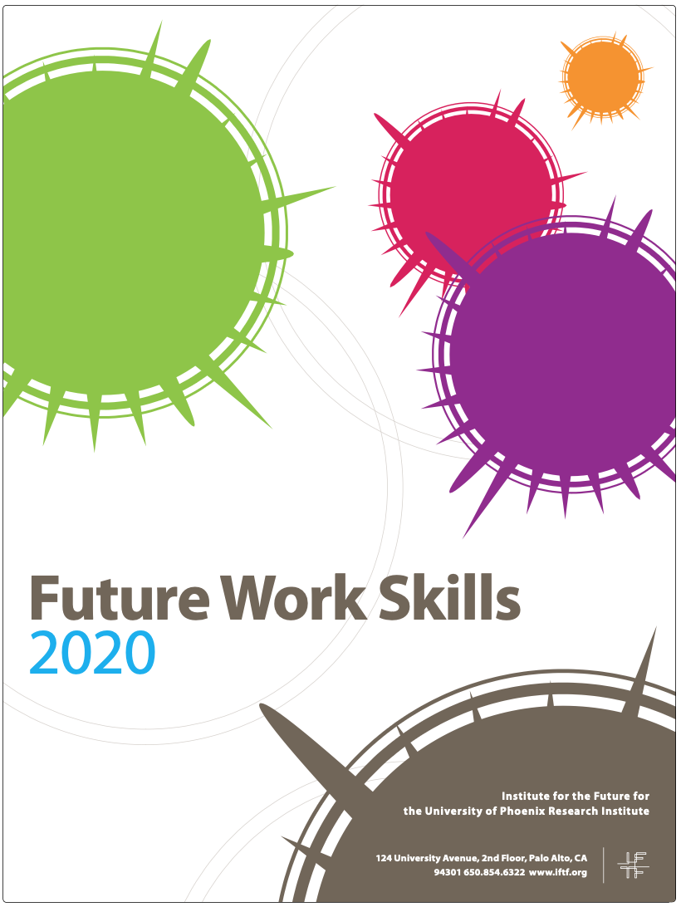
Skills needed for 2020 knowledge worker (IFTF)
Sensemaking (critical thinking)
Social Intelligence (empathy)
Novel adaptive thinking (creativity)
Cross Cultural Competency
Computational thinking (math)
New Media Literacy (social media)
Transdisciplinarity
Design mindset (writing manuals)
Cognitive Load Management (filtering information)
Virtual Collaboration (virtual teams)

Slide 7
Focal points for future vision
Seamless educational system - Estonian educational system that involves both formal, non-formal as well as informal study, enables everyone to keep their skills and knowledge over the course of their life consistent with the needs of labour market.
Consolidation of higher education and increasing the self-liability of the learner - Estonian institutions of higher education offer the same top level education as Nordic and Central European universities and involvement of private capital has increased
Prioritising research and innovation - Estonia makes a radical leap in investments towards research and innovation, laying the groundwork for a general increase in skills in society and for the formation of innovative fields of activity with high added value

Slide 8
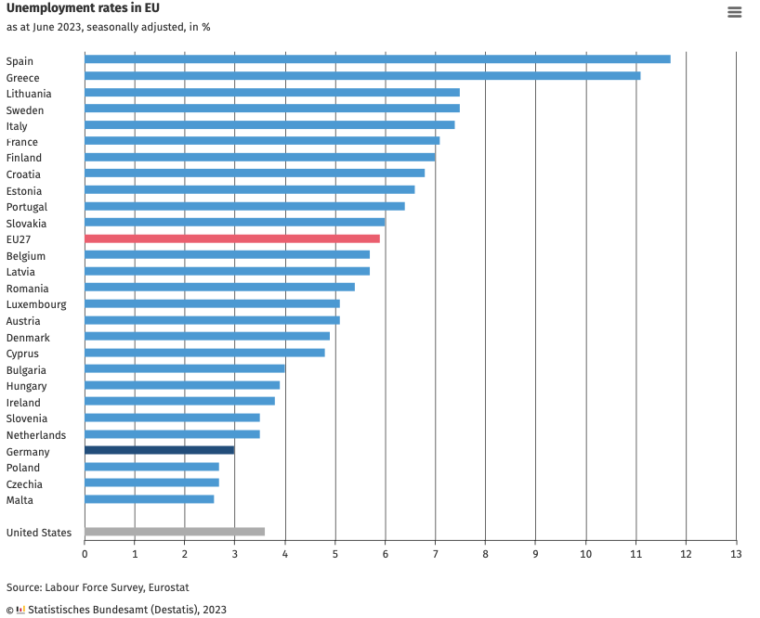
Unemployment
rate in EU

Slide 9
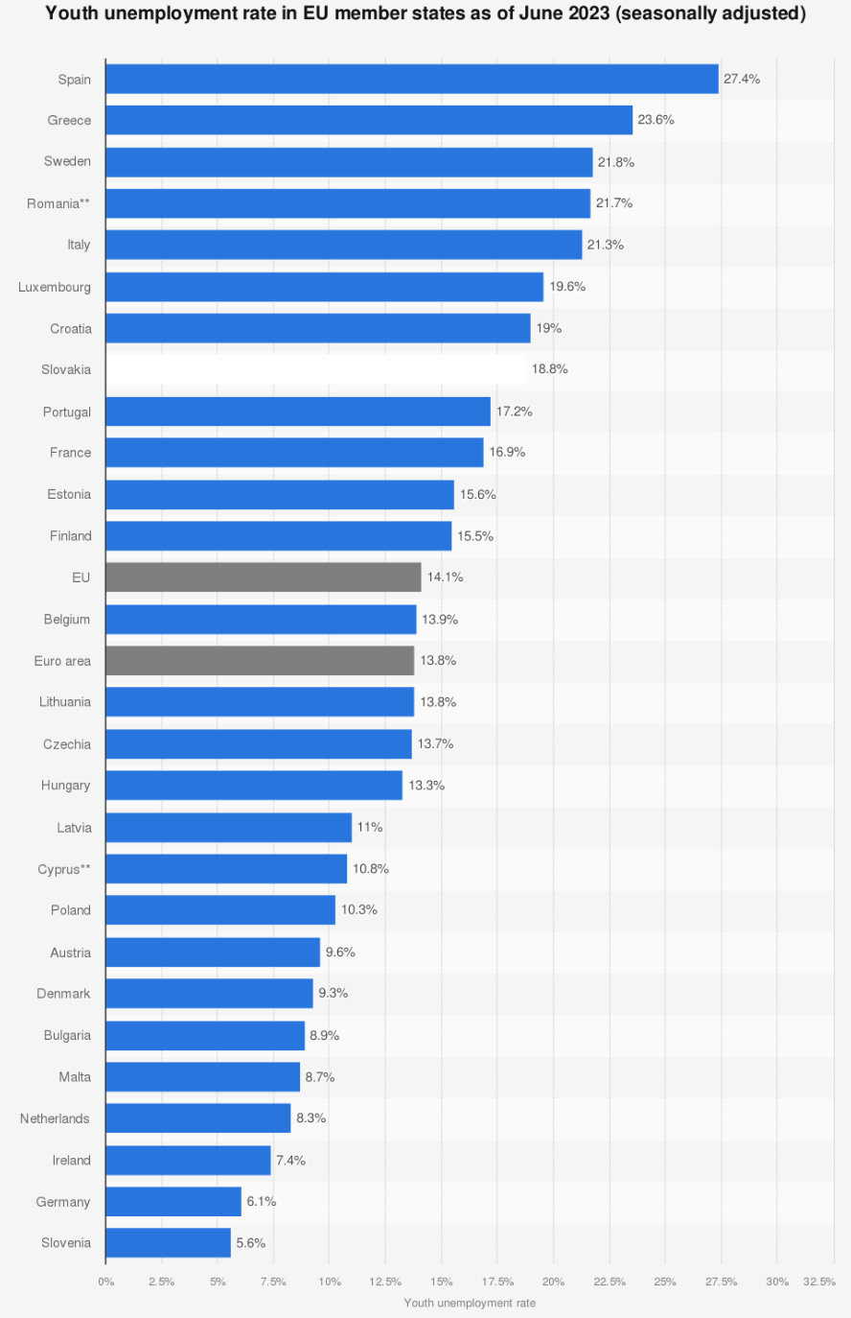
Youth unemployment
rate in EU as of
June 2023

Slide 10
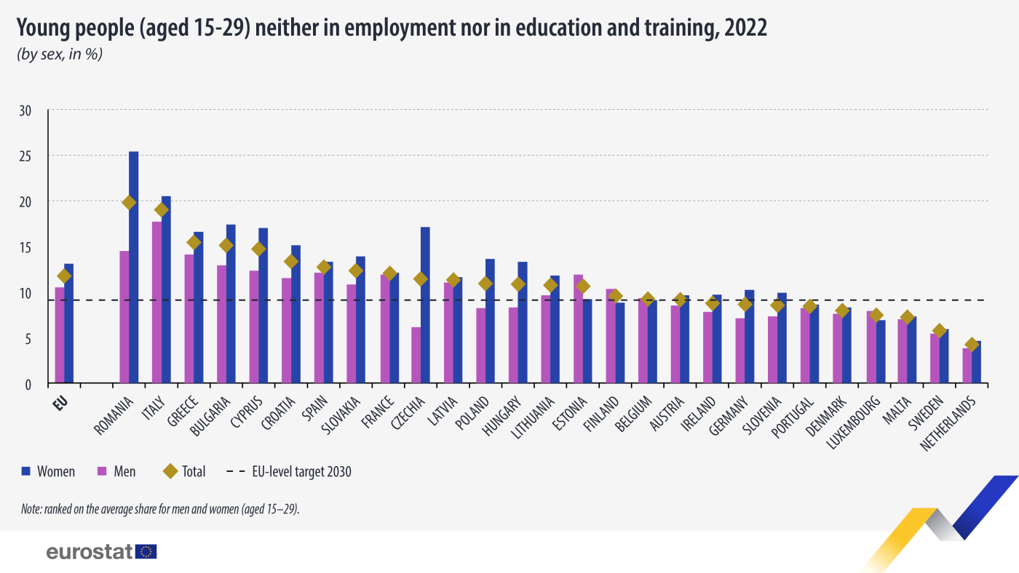

Slide 12
Seamless educational system
The purpose is lack of educational “dead ends” (it must be possible to continue the path of education from every level) and increase in the proportion of people with professional skills within the labour force
Enabling students/pupils to choose a profession/occupation at a later age with a purpose of decreasing the drop-out rate in schools as well as unemployment (lower proportion of NEET people)
Elevating vocational education to the same level as professional higher education will improve later career opportunities; future labour market needs highly qualified skilled employees and specialists with broader knowledge and good learning skills

Slide 13
Seamless educational system (2)
Reducing the differences between applied universities/vocational education and degree studies enables greater movement between the two levels of education due to lower barriers of entry
Individual approach to study path (whilst acquiring secondary education in one school, it will be possible to make a choice between a study path supporting the learning of a profession (in cooperation with vocational education centres) and a study path to prepare for admission into higher educational institution
Nationalising secondary education will enable to be centrally involved in the resources allocation and to monitor that students in different regions would have similar opportunities. nationalisation must be accompanied by a state-coordinated attestation system for heads of school and option for removing from position. Today most of gymnasiums belong to local municipalities

Slide 14
Labour market
Academic universities
Degree studies
PhD
MsC
BSc
Upper secondary
education
12
Degree studies (long cycle)
Professional HE/vocational education
Upper secondary schools for adults
Continuing education,
Informal education,
Hobby education
Life-long learning
Professional HE Diploma studies (applied universities)
Primary education
Vocational
secondary
education
Post-secondary technical/vocational school
Vocational
education without secondary education
Without profession
With profession
In-house training
Labour market
TIME

Slide 15
In-house training
Labour market
Degree studies
12
Upper secondary
education
Degree studies (long cycle)
Life-long learning
Professional HE/vocational education
(short cycle),
Basic education
Professional HE
Applied universities
Upper secondary schools for adults
Continuing education,
Informal education,
Hobby education
Compulsory secondary education
Vocational
education
Educational consortium
Without profession
Vocational education 6-12 months
Vocational education 6-12 months
With profession
Labour market
TIME

Slide 16
Consolidation of higher education
Consolidation of higher education (three public universities, instead of six) in order to reduce duplication.
Developing academic Estonian language, combining it with internalization of higher education
Increasing the self-liability of learners via the development of a novel funding model of higher education (tuition based education)

Slide 17
Decentralization of higher education
Withdrawal from the rigid Bologna system (3+2): implementing short (3+1) and long (4+1 or 4+2) flexible systems of higher education cycle and creating a legal system required for this
Creating a legal system for nano-degrees (study modules of 3-6 months) on master’s level
Increasing the self-liability of learners via the development of a novel funding model of higher education (tuition based education)

Slide 18
Concluding remarks
Technological developments are unpredictable (Chat GPT), consequences: labour market affects, increasing importance of oral expression of students
We need closer cooperation between different levels of education
As labour market changes, education will become more fragmented
and individual (micro credentials)
Decentralisation and individualisaton of education means that regional colleges are important drivers of local developments and labour markets.

