Slide 1
Pan-Baltic Seminar on Post-Pandemic Hospitality Education International best practices in dealing with the post-pandemic challenges related to hospitality education: THE PLACE OF HEI IN THE REGION Outcomes & Conclusions
Elizabeth M. Ineson BEd (Hons) MSc PhD Cert Ed FIH FIT
Visiting Research Fellow, MMU/La Fondation pour la Formation Hôtelière
23.08.2023,
University of Tartu Pärnu College

Slide 2
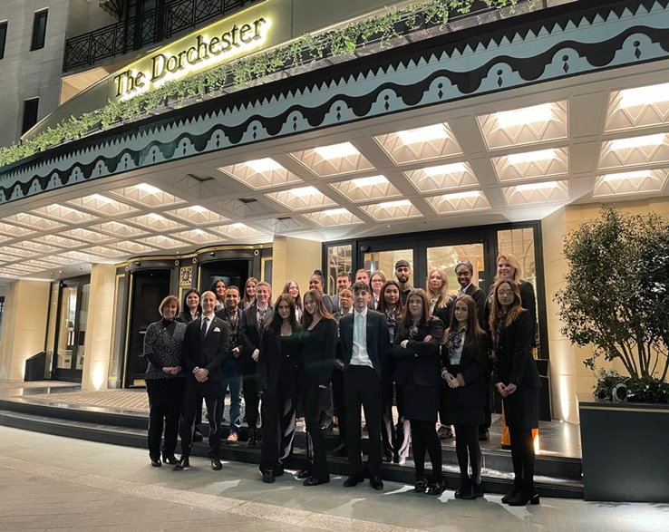
Outcomes: Key Themes
Partnerships: Education/Industry/Government
Fields for study via Courses/Programmes/Units etc.
Teaching/training methods
Skills/Competences
Technology

Slide 3
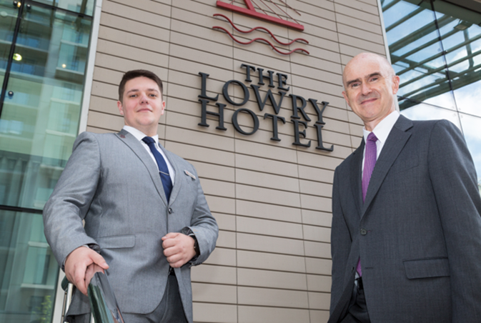
1. Partnerships:
Education/Industry/Government - improved communication; Co-(llaboration), -creation
All internships should be paid
Educators offer professional development & training, e.g. VE/HE combine to offer micro courses in stages with optional breaks to work or discontinue as preferred
HEIs link with professional bodies (e.g. Local/regional/national associations) for mutual support
Industry supports visits & forums; employer face-to-face and international virtual networking events
Industry offers virtual internships & industry based projects
Career advisory support via online job portal & extend alumni links; annual placement, graduate fairs & professional development week; mock assessment centres
Government investment in education & skills’ training
Well designed, effective labour market policies & social protection systems

Slide 4
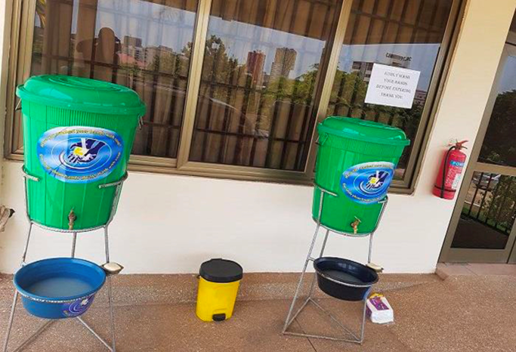
2. Fields for study via Courses/Programmes/Units etc.
Emotional & Practical Intelligence (ability to apply knowledge/skills in practice)
Personal welfare & Mindfulness
Service diversification
Sustainable development
Hygiene, sanitation and guest safety
Business simulation
Stress avoidance & preventative methods
Environmental, Customer experience, Facilities’ & Crisis management
Transactional analysis, e.g. dealing with complaints, difficult customers/staff etc

Slide 5
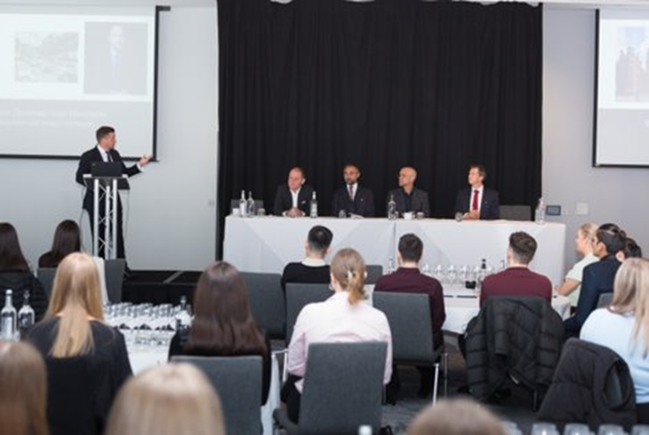
3. Teaching/training methods
Modular courses; remote courses; short courses; micro learning & credentials
Hybrid teaching in listening mode & with interactivity
Train teachers in digital learning & generational learning differences
Diversify lecturer profile (local & virtual); mix students (e.g. PT/FT; languages etc.); distance learning
Self-paced on-the-job/own time training with management evaluation & feedback
Experiential learning/on-line training via scenarios, case studies & VR
Counselling; mentoring; upskilling; retraining; upgrading
Live & virtual guest speakers/lecturers & international visits
Game-based training; competitions

Slide 6
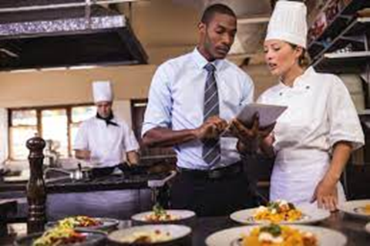
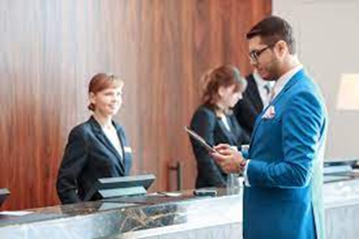
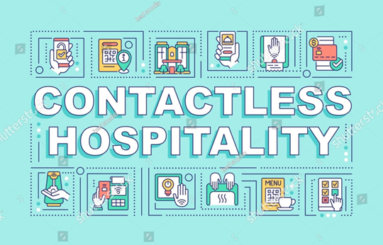
4. Development of Skills & Competences
Personal (e.g. adaptability, positive attitude, critical thinking, resilience, flexibility, confidence; compassionate; empathy)
Interpersonal (e.g. teamwork, respectfulness; communication)
Practical (e.g. F&B Kitchen; Spa etc.)
Ability to multi-task
Embrace new things and make them useful for yourself
.

Slide 7
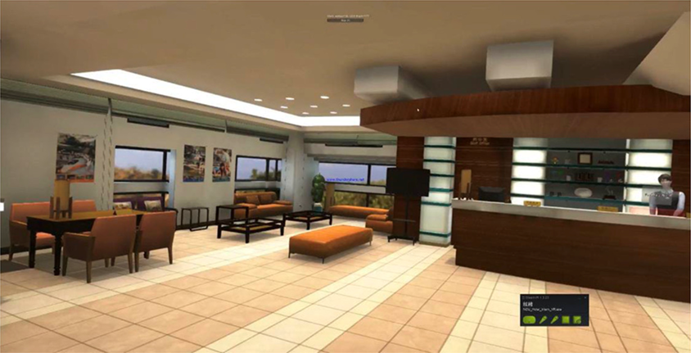
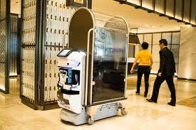
5. Technology
Employ technology to save time & mney, e.g.to reduce printing costs
Faster change implementation
Organisational and digital skills to retrieve, capture, document and manage data
Non-haptic (touch free) employee/guest interaction
Knowledge/awareness of AR, VR & AI applications

Slide 8
SUMMARY
Improve local education/industry/government links; market courses/recruit with a local focus
Create image of tourism sector for ‘people’ via social media; share success stories
Teach online in addition to face-to-face via accredited modular courses
‘Offer on the job’ education & training
Record (practical) demonstrations lectures/in-house training
Allow for generational differences in teaching and learning
Offer counselling and/or upskilling/retraining and/or mentoring programmes
Develop ‘new’ core competences (e.g. emotional intelligence; soft skills)
Focus on technological advances in teaching & learning (business simulations, AR, VR, gamification, AI etc.)
Learn; adapt; react!
THANK YOU FOR YOUR ATTENTION!

