Slide 1
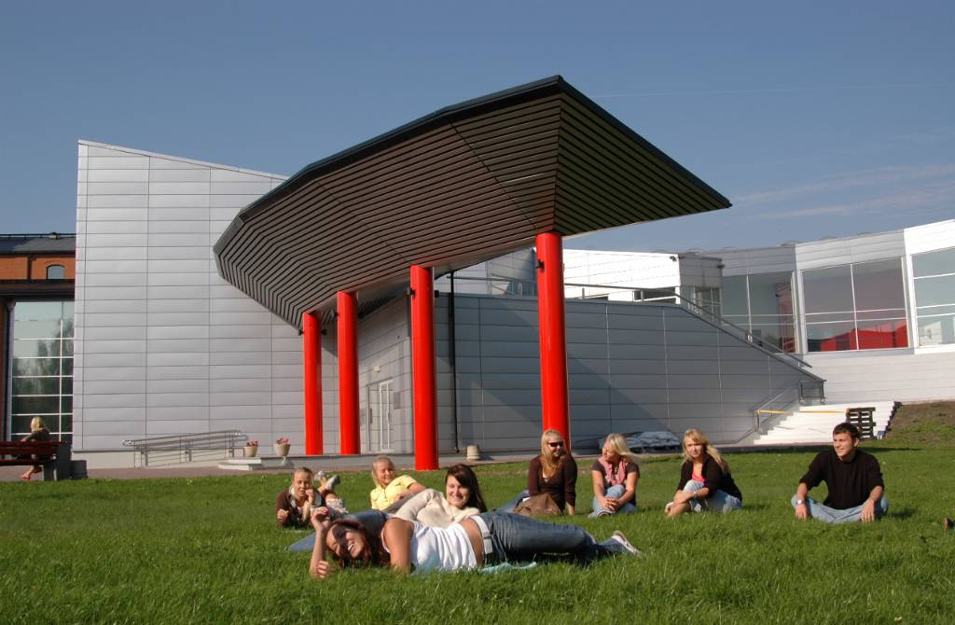
Higher educational institutions’ in regional development. The case of the University Tartu Pärnu College
Garri Raagmaa
University of Tartu
garri@ut.ee
+372 5278899

Slide 2
Regional higher education institutions in regional leadership and development
2017
Garri Raagmaa & Anne Keerberg
Regional Studies, 51:2, 260-272
DOI:10.1080/00343404.2016.1215600

Slide 3
Being Resilient Between the Region and the Higher Education System? Views on Regional Higher Education Institutions in Estonia and Finland
Fresh publication - 2022
Chapter 10
Jari Kolehmainen
Heli Kurikka
Anne Keerberg
Garri Raagmaa

Slide 4
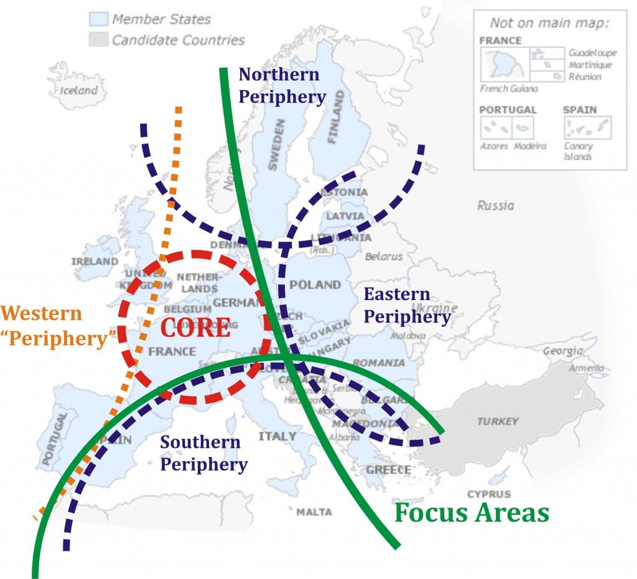
Northern and Eastern peripheries
Source: Ghita, 2013

Slide 5
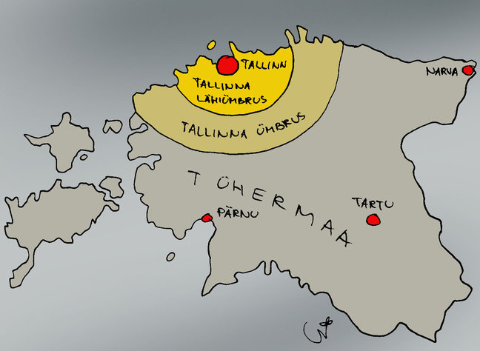
Periphery of the periphery
Translation:
Suburbia of Tallinn
Hinterland of Tallinn
Wasteland (periphery)
Source: Postimees, Urmas Nemvalts

Slide 6
R&D = Innovation
High investment in R&D does not guarantee innovation and development of the regions (Capella 2011).
Tartu case: bioscience versus software industry.
Geography matters: knowledge and new values take root in the close interaction of PEOPLE (Rutten 2016), not between institutions.
The importance of life-extended learning.
Sticky knowledge (Asheim ja Isaksen 2002).

Slide 7
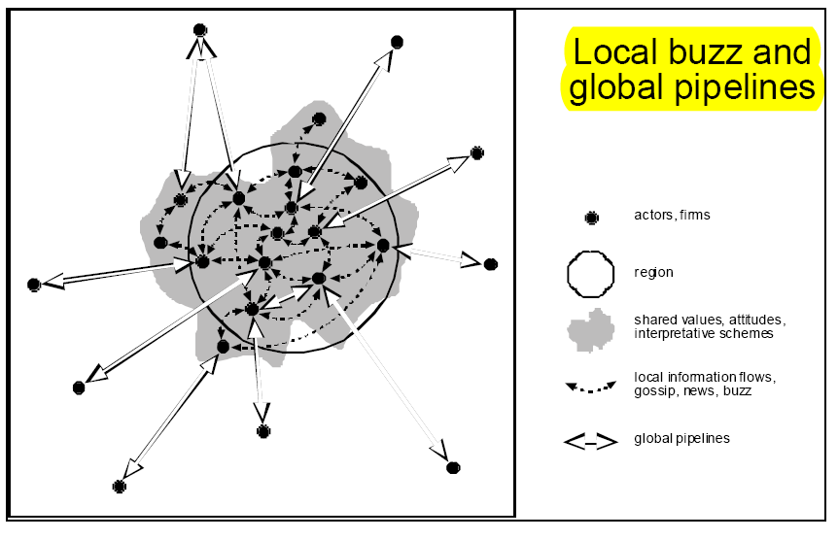
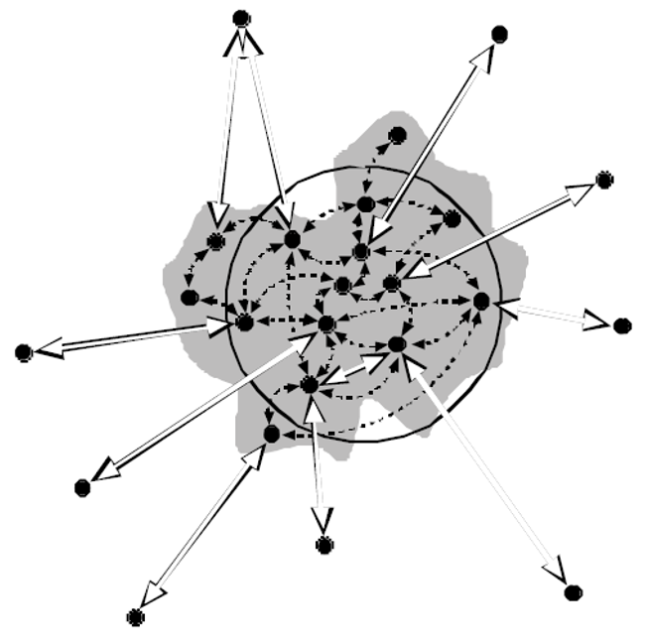
Business is a social matter
Source: Bathelt et al 2004

Slide 8
HEI in the regional innovation system (RIS)
Foreign partners (universities, agencies, etc.)
National university/ies
State agencies
(G L O B A L) P I P E L I N E S
RIS
Regional
HEI
Regional development agency
Public authorities
L O C A L B U Z Z
Secondary schools
Enterprises
Vocational schools
NGOs

Slide 9
Main questions
What is a regional HEI (RHEI), and how does it differ from a classical university?
How to create an improved regional development (RD) capacity through the involvement of higher educational institutions (HEI)?
What are the inner processes and environments whereby HEIs and other regional innovation structures operate?
How can RHEIs be more effective and achieve resilience in the long run?

Slide 10
HEI in regional development
AS AN INSTITUTIONAL ENTREPRENEUR

Slide 11
HEIs stimulating economic development
Relatively broad consensus that the presence of universities stimulates economic development
HEIs have a significant impact on the businesses and organizations of their location region (Vaessen & Velde 2003)
HEIs may serve as the intermediaries of global pipelines and contribute to regional buzz (Bathelt et al. 2004).
HEIs may assume the role of experts in local decision-making bodies (Arbo & Benneworh 2007) and act as strategic partners.
There was a boom of setting up RHEIs in order to enrich regional knowledge capacity in many European regions in the 2000s (OECD 2007, NordRegio 2009).

Slide 12
What are regional HEIs, and what tasks do they perform?
Located outside traditional university centres
Main tasks:
knowledge transfer
through education and human resources development
knowledge creation
through research and technology transfer
cultural and community development
part of the RIS, entrepreneurial ecosystem
OECD 2007
participation in regional strategy-making ?

Slide 13
HEIs increasing regional competitiveness. How?
„Classically“ through
(1) human resource supply,
(2) knowledge creation and
(3) technology transfer.
Regional HEI may also act as:
(1) a service provider,
(2) a stakeholder, and
(3) a strategic partner (James & Clark 1998)
Setting up a new institution should have considerable potential to shape existing routines (Sotarauta 2009) → and key institutions for improving the institutional framework.

Slide 14
Narrow R&D versus broadly based innovation policy
‘One size does not fit all!’
Tödtling & Tripple 2005
STI (Science, Technology, Innovation)
high-tech/science push / supply-driven
→ “Big science” & Transnational corporations
DUI (Doing, Using, Interacting)
Competence building / organizational innovations / social innovations/market - demand - user driven
Broadly based innovation policy
→ Regional HEIs Lorenz & Lundvall 2006

Slide 15
HEIs in peripheries: DUI ja CCI type RIS
The facilitator’s role of RHEIs in learning and adaptation processes is particularly vital in peripheral regions characterized by low densities and limited access.
Small and peripheral regions with limited human and knowledge resources, located far away from large university cities, usually cannot afford STI-type knowledge support systems (Lorenz & Lundvall 2006).
Regional HEIs may also act as DU innovators and network brokers but try to set up CCI (complex, combined) capability and provide company-based innovation through an experienced labor force and business services (Isaksen & Karlsen, 2012).

Slide 16
RHEIs contributing changes!
Local politicians and small businesses tend to maintain the status quo.
There is a need for new dynamic leaders who can cope with constantly changing circumstances.
HEIs employ intelligent and capable people, also with leadership qualities
when interconnecting existing governance and regional structures for generating synergetic effects;
would it avoid local elites to stagnate?
HEIs can give a wake‐up call for change, design and lead regional development actions, function as a forum and meeting place for local leaders…

Slide 17
RHEI as a development Anchor Institution
Knowledge-based regional development should have a stronger focus on actors, agencies, and their interaction and governance (Flanagan et al. 2011).
New policy paradigms emphasize the importance of creating broad-based coalitions that harness knowledge actors to create new opportunities (Asheim et al. 2011; McCann & Ortega-Argilez 2013).
Contributing to evolutionary path creation and path-breaking processes as part of creating new regional futures (Goddard 2012).
Doubly peripheral Scottish community colleges become part of the mainstream higher education system (Charles 2016). → UHI
However, „Synergy and creativity can help promote universities’ contributions to peripheral regions, but the conditions to deliver this synergy are easily disrupted, and a vast constellation of regional and national supporters are necessary to ensure that synergy can be delivered“ (Keerberg 2018).

Slide 18
How does the presence of RHEIs impact the agency of a peripheral region?
A HEI as an organization and a nest for talented individuals may interact with other institutions and proactively create new and modify existing ones (Dimaggio, 1988).
HEIs located in the peripheries act not only as educators and technology transfer units but also as Development Anchor Institutions that
create new institutions and rules – change the local entrepreneurial culture (or ecosystem) and
contribute to local identity and pride as well as increase the visibility → of new path creation.

Slide 19
How regional HEIs can be more effective?
Young and small organizations cannot be defensive per se because they have to grow, or when this is not possible, then proactively prove their importance:
proposing new (innovative) projects, optimizing performance, act in a flexible manner
Leadership quality is essential
The dynamics depends pretty much on local leaders’ ambition and proactivity
Achieving shared leadership and a common vision is essential (selling the idea to politicians)
Networking as a functional strategy
Shifting jointly national policies (lobby)
Convincing local allies, keeping them prepared, and alerted

Slide 20
More findings
Peripheral regions are institutionally thin, and this allows to convince decision-makers more efficiently and allows faster institutional changes
Super tanker VS kayak
Small regional HEIs located in small towns tend to be more proactive in contributing to regional development actions:
Limited number of strategic partners
Better visibility in a smaller place
Question of life and death of RHEIs
The contribution of HEIs to local democracy is crucial:
acting as a democracy watchdog
arranging forums and discussions on a neutral ground
Institutional lock-in is still highly probable due to
limited human resources
local networks’ pressure on HEIs
lack of interest from the mother university

Slide 21
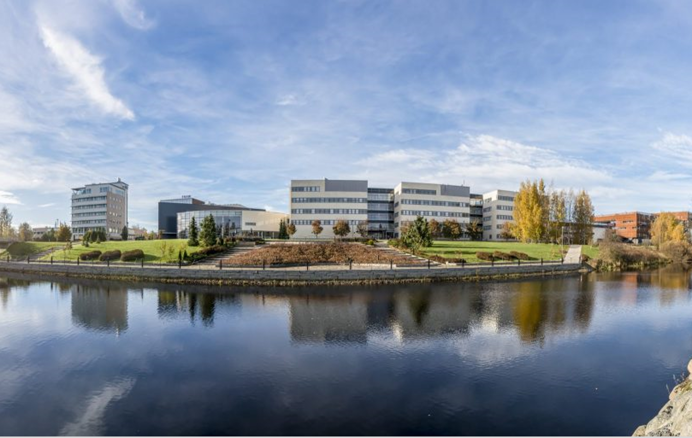

Slide 22
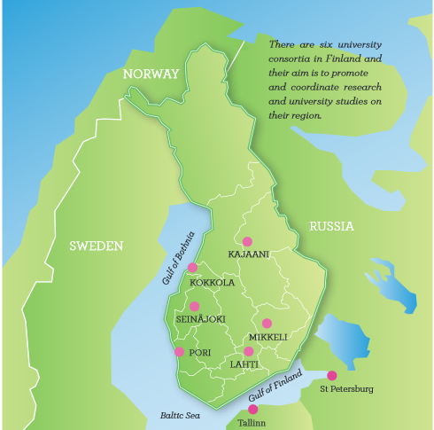
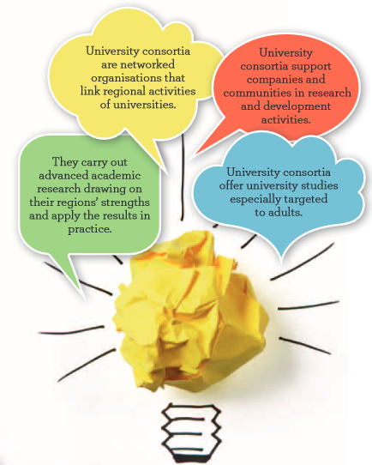
University consortiums in Finland

Slide 23
University consortia’s roles
University consortia and the local economy
UC is a significant local employer for academics
Adult education and extension studies increase the human capital
Universities in regional/local innovation
Collaboration with local business and development organizations
Extra-regional networks of the University consortia’s
Societal, cultural, and community engagement
UC shapes the local community also in the societal sense, involved in the local and regional policy-making processes.
Secured on the national level by the law.
Physical presence in urban structure
Campuses are shaping the cities physically

Slide 24
The case of the University Tartu Pärnu College
and other Estonian university colleges
Comparison with Finnish University consortiums

Slide 25
Regional HEIs in Estonia
Entirely an ad hoc process without any national plan or policy
private universities established their branches in the early 1990s
public universities followed and formed their regional HEIs in the mid-1990s
In 2005, there were 44 HEIs + ca 30 regional units in Estonia
2004 Governmental University College programme
2009 ERDF financed Competence Centre programme
Since 2009, the RHEIs student numbers have started to decline because of demography and changes in the financial system (free higher education)
In 2016, the number of HEIs dropped to 21, incl. 6 public universities
2021-2 extra-governmental support (ca à 200k€) for regional colleges

Slide 26
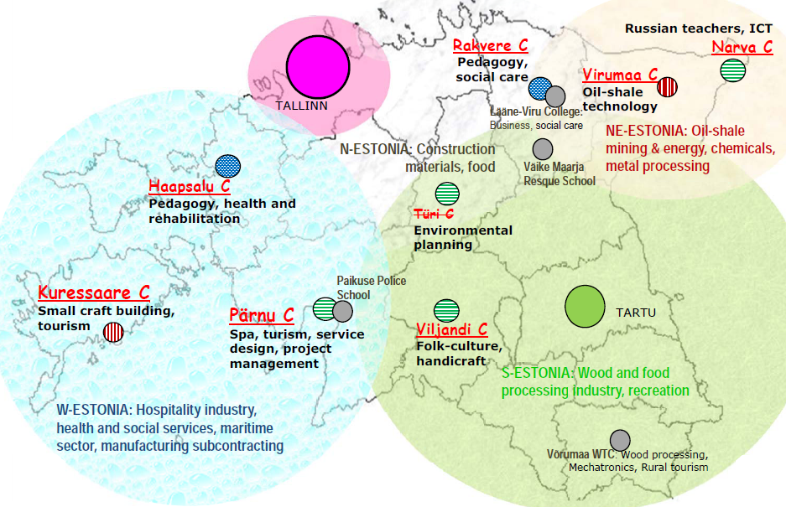
Regional HEIs in Estonia
Competence centres

Slide 27
Why regional HEIs were set up?
Rather unique fenno-ugric model of university filials
Local stakeholders, outside quality control, combined governance
Main initiators:
Local/regional authorities and universities, local firms (E)
LG and universities, local firms, national government (F) – more balanced
Motivation behind the set up decisions:
Regional policy tool (G), regional competitiveness (LG), extra revenues and students (U) (F)
Copying Nordic example (LG), market competition of universities (E)

Slide 28
Estonian VS Finnish RHEIs
Actors and sources of development:
(Founding) directors, regional politicians and civil servants, entrepreneurs (E)
→ Pretty much ad hoc action, minimal local contribution, project-based
Local politicians and civil servants, university leaders, entrepreneurs willing to contribute research (F)
→ Following locally agreed lõng-term agenda (aiming to get „own HEI“)
Profiles
Mainly teaching and some development actions, a clear need to extend research activities (E)
Extensive (applied) research and adult training – more balanced sources of income (1/3 model) (F)
Seinäjoki employs 24 research professors with their teams
Valmet as main contract partner for Kajaani

Slide 29
The presence and future of RHEIs?
Critical shocks of the last decade
Financial crisis 2008-10, austerity, Russian war
Administrative reforms, governmental policy change, centralization
Demographic decline in peripheries, lack of students
Critical issues, actions
Sustaining customer base & revenues
Attempting to put eggs in different baskets
Collaboration with local authorities, schools and firms
Impacting national and university policies, lobby
Interacting with regional authorities and other actors
Willingness to contribute to local development

Slide 30
Pärnu College departments & progammes
Entrepreneurship
Entrepreneurship and Project Management (BA)
Design Thinking and Digital Marketing (BA)
Service Design and Management (MA)
Entrepreneurship Based on Person as Brand (MA)
Tourism Studies
Tourism and Hotel Management (BA)
Wellness & Spa Service Design and Management (MA, ENG)
Accommodation Management (with Pärnu Vocational Education Center)
Social Work Administration
Social Work and Rehabilitation Administration (BA)
Person-Centered Social Innovation (MA)
Resource Management – department in spe
Micro degrees on the green deal and applied resource economics

Slide 31
Research & Development Department
International exchange, cooperation, networking, and strategic partnerships
Research Center runs projects, organizes (applied) research and events, counseling and consulting, training
Design Thinking Lab
Academia Pernaviensis
Multiversitas
Science communication
Hackaton arrangements

Slide 32
KOBAR/CLUSTER → KOBAR2 → KOBAR3
Cluster for cooperation between entrepreneurs and business stakeholders for knowledge transfer
Core partners: County Development Centre/Business Incubator ja College
Includes joint physical premises
Collaborative platform for entrepreneurs, entrepreneurship support structures, and educational institutions in the county
Proacative participation in local/regional strategies
Promoting business collaboration, generating thematic sub-clusters
KOBAR 2 – innovation centre
KOBAR 3 – extended campus

