Slide 1

The Future of Higher Education:
Trends and Challenges in Estonia
Science communication forum "The Place of the Higher Education Institution in the Region“
23.08.2023
Uku Varblane
Foresight Centre of Estonian Parliament

Slide 2
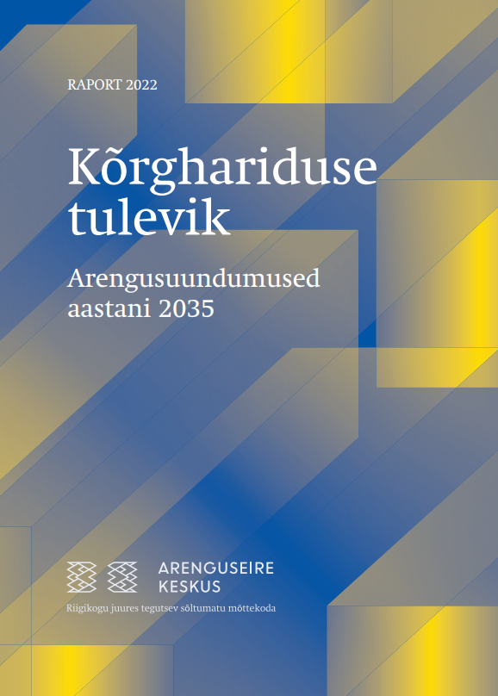
Foresight project „The Future of Higher Education“
Materials:
2 research reports,
3 short reports,
2 webinars,
HE financing calculator
+ other materials
Cooperation partners:
Riigikogu Culture Committee, higher education institutions, HTM, EKKA, HARNO and others
The importance of higher education
Development trends of higher education
Challenges of higher education in Estonia
Higher education financing
  Higher education funding models
  Student finance
  Financing scenarios in Estonia

Slide 3


Development trends of higher education
Notes:
Four most important development trends

Slide 4


Digitalisation might not lead to cost reduction
Digital tools can increase efficiency, promote learning, teaching and communication
New technology driven business models offer cooperation opportunities for higher education institutions, but also increase competition
To remain competitive, additional value must be offered to students - for example, a more personalized approach
Examples of the trend in Estonia
Residents of Estonia (aged 25–64) are one of the largest participants in online courses in the European Union after the Netherlands, Iceland and Slovenia.
Several Estonian higher education institutions are vigorously developing MOOCs.
TalTech's XR Center allows the use of virtual and augmented reality technologies Futuclass in teaching, it has often been applied, for example, in architectural education.
Notes:
One trend that cannot be overlooked in higer education
Examples: classroom learning practices,communication, possibility to watch online lecture later, study groups, Zoom chats, admin tasks – enrollment etc
New: online courses, interactive learning programs, language learning games, etc. allow you to improve yourself
In the future, for example , it will be possible to offer both a personalized learning experience and lower costs by using artificial intelligence applications – virtual study assistants
MOOC - Massive Open Online Courses

Slide 5


Internationalization expands the market, but also increases competition
In addition to student mobility, other forms of international cooperation are becoming increasingly important, such as joint study programs
For Estonian universities, international students provide an opportunity to generate revenue, but it is also important to connect talents with Estonia
A foreign university might start offering degree programs in Estonia
Examples of the trend in Estonia
The proportion of international students among all students studying at Estonian universities has significantly increased in recent years (11 %); in the coming years, students of Ukrainian origin will contribute to the growth more than before (+222%).
Estonian Business School also offers degree programs in Finland (EBS Helsinki).
Notes:
Student mobility is only one aspect, the proportion of international students is reaching a level where it no longer needs to be targeted – 11.6%.
Internationalization at home – integrating national and multicultural dimensions into curricula within the domestic learning environment.
Offering postgraduate education in other countries.
International open access web-based massive open online courses (MOOCs).

Slide 6


Universities solve societal problems and drive major changes
Higher education institutions are expected to operate on two levels:
  Global crises and disruptions - from the green transition to artificial intelligence
  Contributing to the development of the local economy and living environment
Examples of the trend in Estonia
During the latest crises (corona pandemic, war in Ukraine), higher education institutions have been on the "frontline" and the demand for various support services has increased.
Notes:
The Role of Higher Education Institutions in Society is increasing
Expected to contribute in solving global crises etc
The curriculum should be aligned with the region's economy and development prospects.

Slide 7


Higher education must align with evolving expectations – more personalised approach
Age distribution of higher education admissions
An increasing share of students do not come directly from secondary school
Microqualifications or learning bites
Unbundling of curriculum, but to certain extent
Offering a personalized approach is costly, but if not done, academic performance suffers, students drop out, turn to alternative service providers, etc.
Share of enrolled students (%)
Source: Estonian Education Information System via Haridussilm portal
Notes:
Increased Diversity
The 25+ age group has grown by +10%.
Students are more aware of their needs and expectations, and are more demanding.
Microqualifications have the potential to improve access to higher education, support self-development and personalized, student-centered learning, while also serving employers' interests; universities are actively developing them.
Example of a pilot program.

Slide 8
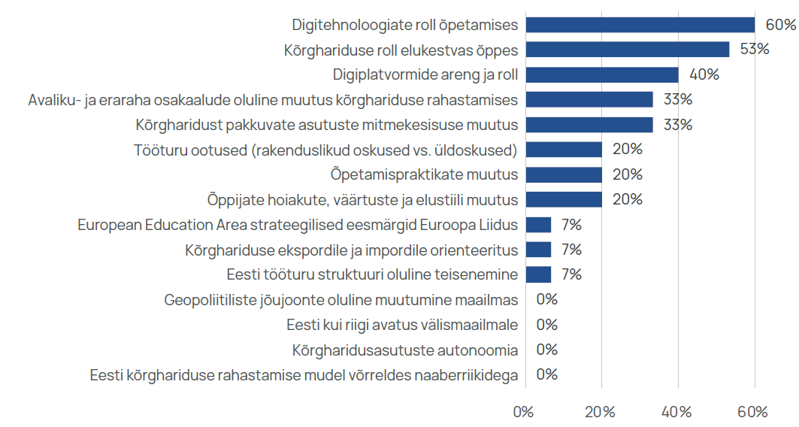
Estonian education experts' assessments of the importance of the proposed factors (N=15)
The role of digital technologies in teaching
The role of higher education in lifelong learning
Development trends and role of digital platforms
A significant change in the proportions of public and private funds in higher education
Change in the diversity of higher education institutions
Labor market expectations (applied skills vs general skills)
Change in teaching practices
Change in students' attitudes, values, and lifestyle
European Education Area strategic goals in European Union
Orientation towards higher education export and import
An important transformation of the structure of the Estonian labour market
A significant shift in geopolitical powers
The openness of Estonia as a country
Autonomy of higher education institutions
Funding model of Estonian higher education compared to neighboring countries
Notes:
With the help of Estonian education experts, various factors were ranked based on perceived importance.
Learning is much more digital, but the workload of lecturers does not decrease

Slide 9
Higher education tomorrow : three short stories of the future of higher education
National lifelong learning
Elite higher education
Virtual university
  Higher education institutions have regulatory advantages in the continuing education market
  Universities diversify learning opportunities, paid continuing education generates additional revenue
  Non-academic certificates remain important only in limited fields
  Higher education institutions expand both in terms of students and teaching staff
  Competitionin the lifelong learning landscape is strictly market based
  Other education providers are responding to changing expactations more quickly, capturing market share and filling the role of higher education institutions in many areas
  Funding of higher education relies mainly on public funds
  Higher education institutions are shrinking and the sector as a whole is shrinking
  Learning is becoming digitized both in content and format and is much more global than today
  Machine learning and artificial intelligence applications provide a personalized learning experience
  Higher education institutions provide courses on digital platforms, but profitability is limited by the rules and conditions of the platform
  State funding of higher education remains at the current level, ensuring only essential and more challenging-to-digitize education
Notes:
1: The role of higher education institutions in the continuing education market is growing for two reasons, higher education institutions are actively working in order to meet the needs + reg advantages
2: where higher education institutions react slowly to changing expectations and are not given regulatory advantages in the landscape of lifelong learning
3: the educational landscape is consolidating in the hands of large digital education platforms and becoming more global. Estonian higher education institutions partially become subcontractors , offering courses on digital platforms .

Slide 10
Challenges of higher education in Estonia

Slide 11
Compared to other OECD countries, the dropout rate is high
Bachelor students who are no longer in student status three years after the end of the nominal term and have not graduated (bars) or who are no longer in student status at the beginning of the second academic year (diamonds).
Source: OECD (2019)
Notes:
Defining dropout
33% of BA students do not have 3 years after the nominal graduation time no longer in student status and did not graduate (in Finland 17%)/
A lot drops out just in the year of defending.
Would be interesting to discuss the reasons from the perspective of diferent regional colleges. Probably the causes are different?

Slide 12
Smoother integration of working and studying is compromised by the pursuit of completing within the nominal timeframe
Student employment during the 2019-2020 lecture period (before the start of the corona pandemic)
Students work a lot - to cover living expenses, but also to gain work experience
57% of working students say that their work is very closely or closely related to what they are studying
Falling behind in the curriculum means tuition fees and loss of grants
Working and studying full-time places a heavy burden on students
Source: Eurostudent VII round ( Eurostudent 2021)
Notes:
Student employment – students work a lot; regularly=20+ hours a week
1. 78% work to cover living expenses
2. More and more people are going to study alongside working, not working alongside studying
2. The Riigikontroll analysis in 2019 did not show a significant connection between dropout and employment.
2. A third feel that work is a affecting their studies in a negative way. 2x more than the EU average;
3. High workload, mental health
Raud compares optimization to baking a cake, where you double the speed and cut the time in half — the result is burnt on the outside and raw on the inside.
The proportion of those admitted to master's studies at the expense of bachelor's and applied higher education has increased: 22.6% in 2010, 31.5% in 2021.

Slide 13
Difficulties with covering living expenses has been limiting access to higher education
Need-based grant amounts 2013-2022
Need-based study grants intended to cover living expenses have been small and a relatively small proportion of students (24%) are eligible
The terms of the student loan are still unfavorable
Average expenses for a non-working student 576 euros per month (Eurostudent 2021)
2013-2023 | From 2023/2024
220 EUR | 440 EUR
135 EUR | 270 EUR
75 EUR | 150 EUR
Source: RES (2021). In Estonia, 220.5 euros per month is considered the minimum living wage.
Notes:
Access to higher education is hindered by the possibilities of covering living expenses; a growing topic in today's inflationary environment
Need based grants were unchainged for 10 years. Depends on the Average gross income per family member
Up to 24 years old is considered part of the family even if not living with them. If students are separated from their families, more than half should receive need-based subsidies.
2. The student loan will be cheaper
Consider tuiton free studying for part-time students in order to allow them to combine working and studying

Slide 14
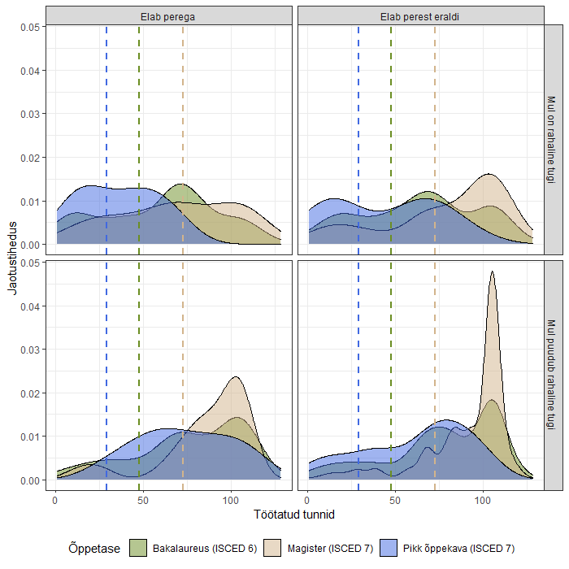
Is working opportunity-based or need-based?
The lack of family support (and studying in another city) correlates with the intensity of work
Source : Eurostudent VII; K. Põder et al (2023)
Notes:
Empirical evidence whether working is opportunity-based or need-based?
With the support of the family, the distribution of work is fairly even
This is just correlation not causation!

Slide 15
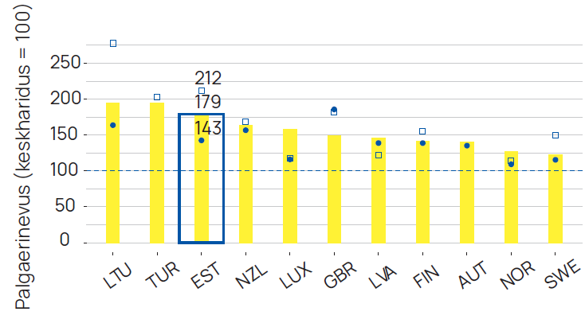
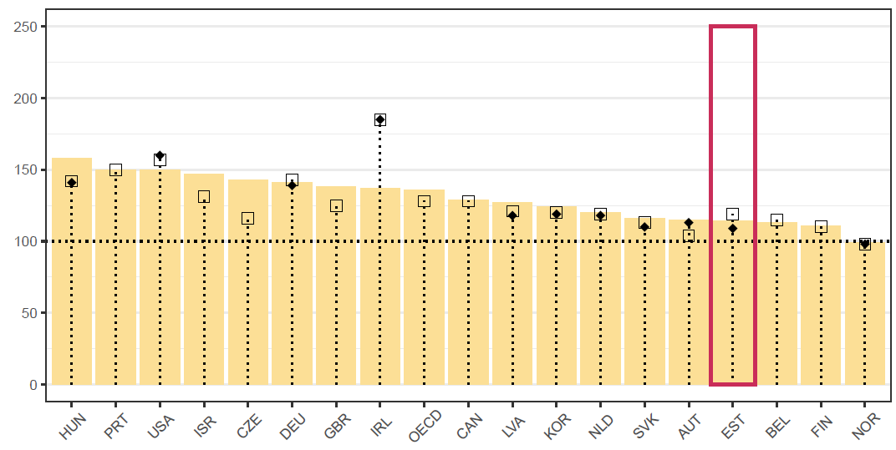
The impact of higher education on wages does not fully appear in statistics – wage premium might be underestimated
Salary difference (secondary education= 100)
Bachelor's degree salary bonus among 25-34 year olds (secondary education = 100);
dotted diamond: 2019, dotted square: 2018, bars: 2015.
Source: OECD (2021)
Salary of workers with a bachelor's degree compared to those with a secondary education in the same year (secondary education = 100)
Source: OECD (2020)
Notes:
Wage premium may be underestimated . There are many who have attended and benefited from higher education, but have not graduated, do not have the degree. Eg in ICT . This moves the reference up.
International studies often use sample data, technical school education (tehnikumid) overrepresented
Using register data, the wage premium is a lot alrger in Estonia
Circle 5, column 3, square 1 year after graduation. The purpose is to compare persons with the same number of years of work

Slide 16
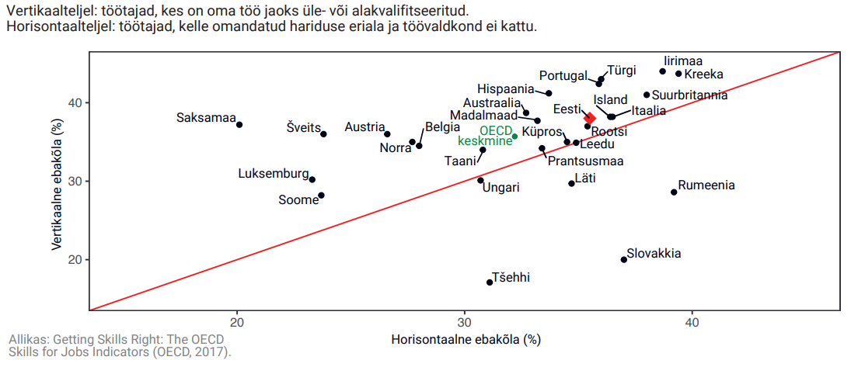
Labour market mismatch: employers do not value the qualifications of older women
Vertical axis: workers who are overqualified or underqualified for their jobs
Horizontal axis: workers whose education and field of work do not match
4,000 people with bachelor's, master's or doctorate degrees do menial jobs (ISCO 9)
The great discrepancy between education and profession in Estonia is due to labor market problems rather than educational problems – the case of older women
Vertical mismatch (%)
Horizontal mismatch (%)
Notes:
Mismatch between qualifications and labour market needs
The overall picture is not bad, but if you have a closer look, some problems arise
1. an additional 5,300 people with special secondary education - keskeriharidus
1. Among service and sales employees, there is also a lot (27%), including much more than in the Nordic countries
1. At the same time, less than average among managers and top specialists
3. There are attitudes and stereotypes in the labor market
Wasteful, reduces return on investment in education

Slide 17
The country's higher education spending has not kept pace with GDP and wage growth
Government expenditure on primary, basic, and secondary education are increasing at a faster rate
Source : Statistics Estonia ( tables RR056, RAA0012, PA001).
Source : Statistics Estonia ( table RR056).
Notes:
High dependence on government budget decisions
The same conclusion was reached in other countries - higher education is not such an important issue politically, it remains in the shadows

Slide 18
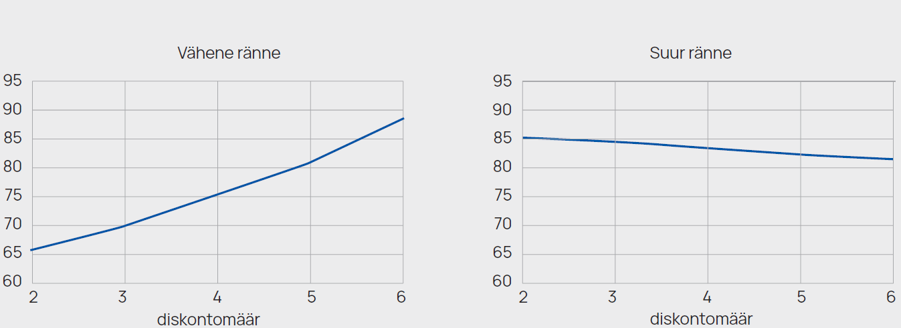
Optimal share of state funding is 75-80%
With limited student mobility, the government's optimal share of higher education funding is 75%
In case of high mobility, i.e. active migration scenario, government share should account 80% of the total funding
Optimal share of state funding in higher education (%)
Source: Männasoo et al . (2022)
Notes:
Economic modelling excercise that maximizes individual income and national income
In the case of a high migration, the government's optimal financing rate decreases, as the risk of not earning back the invested income increases.
Intertemporal utility optimization
Two periods, 5 years of study, 35 years of work

Slide 19

Possible solutions
A less radical solution to the problem of sustainability of higher education funding is to increase operating grant (tegevustoetus) with making the conditions of loans and grants more favourable
A more fundamental change would be to set tuition fees at either a low or higher level along with reforming the loan system, including linking repayments to income
More ideas for higher education extra money for inclusion or internal efficiency to increase
Experimenting with vouchers in areas with higher market demand
Tenders to provide education for specific specialists
Creating regulatory advantages for universities in the continuing education market
Tax exemptions for companies when paying student loans
Photo: Pexels.com
Notes:
Two ways to solve the financing problem
The organization of higher education financing must also take into account the different "market power" of universities and universities of applied sciences.
Intervention at earlier stages of potential students' lives to address earlier limitations
Threshold for income

Slide 20
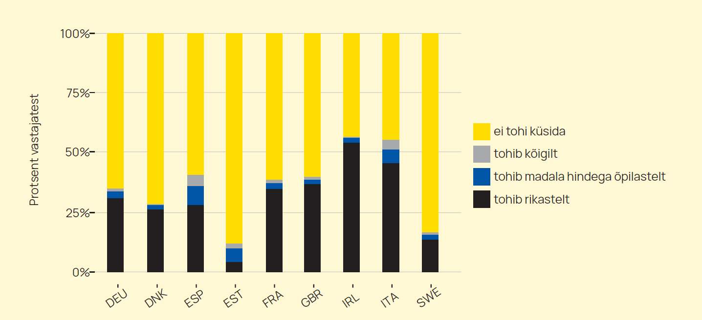
Social attitudes do not support tuition fees
Source: Põder et al . (2022) according to the INVEDUC study.
Notes:
Social attitudes reflect the current system. Those who have not paid for their own studies expect others to be able to study for free, and vice versa, those who have paid for their own studies support tuition fees
Respindents prefer setting tuition fees for students with lower grades rather than students with more advantaged backround (rich)

Slide 21
Description of financing scenarios
Continue in the same way
Growth of state funding
Low tuition fees
Market-based tuition fees
  The operating support is increasing with the historical growth so far, i.e. approximately 3% per year
  There is no tuition fee
  The student loan interest rate is 3%, the maximum loan amount (2,500 euros per year) does not change
  Need-based study grants will not change (maximum rate 220 euros per month) and the proportion of recipients (14%) will not increase
  The operating support will increase by 10% per year for the next six years
  There is no tuition fee
  The student loan interest rate is 1.5%, the maximum loan amount is 4,000 euros per year
  Study grants are increasing (up to 300 euros) and the proportion of recipients is also increasing (20%)
  Operating support is increasing with the historical growth so far
  A uniform tuition fee of 1,000 euros per year is established, 20% of students are exempt from the tuition fee
  Student loan repayment becomes income dependent – repayment starts at 1.5 times the average salary
  The student loan interest rate drops to 1.5% per year , the maximum loan amount is 1000+4000 euros
  Study grants are increasing (up to 300 euros) and the proportion of recipients is also increasing (20%)
  The growth of the operating allowance is frozen for the next five years
  A uniform tuition fee of 5,000 euros per year is established, 20% of students are exempt from the tuition fee
  Student loan repayment becomes income dependent – repayment starts at 1.5 times the average salary
  The student loan interest rate drops to 1.5% per year , the maximum loan amount is 5000+4000 euros
  Study grants are increasing (up to 300 euros) and the proportion of recipients is also increasing (20%)
Notes:
Operating support as the main instrument has grown by an average of 3% per year in the last five years

Slide 22
Comparison of scenarios
 | Continue | Growth of state funding | Low tuition fees | Market-based tuition fees
The most profitable for universities | - | +95 mln | +29 million | +110 mln
The most economical for the country | - | +102 mln | +34 mln | +36 million

Slide 23

Summary
The long-term competitiveness of higher education institutions depends on their success in the lifelong learning market
Free higher education alone does not guarantee equal access to higher education
Full-time study can no longer be considered the norm, so graduation in nominal time cannot be the main funding criterion either
Higher education institutions are shouldered with with new tasks, but the financial support remains scarce
Photo: Pexels.com
Notes:
2. There is free higher education in Estonia, but this alone does not guarantee equal access

Slide 24

Thank you!
Contact:
Uku Varblane uku.varblane@riigikogu.ee

