Slide 1
The mandate for maritime spatial planning and land-sea interactions in Estonia within a rethought multilevel, integrated and inclusive governance framework
Heli Einberg, Kairit Kase, Pille Metspalu, Garri Raagmaa and Henn Ojaveer
Pärnu, Estonia, 24 August 2023

Slide 2
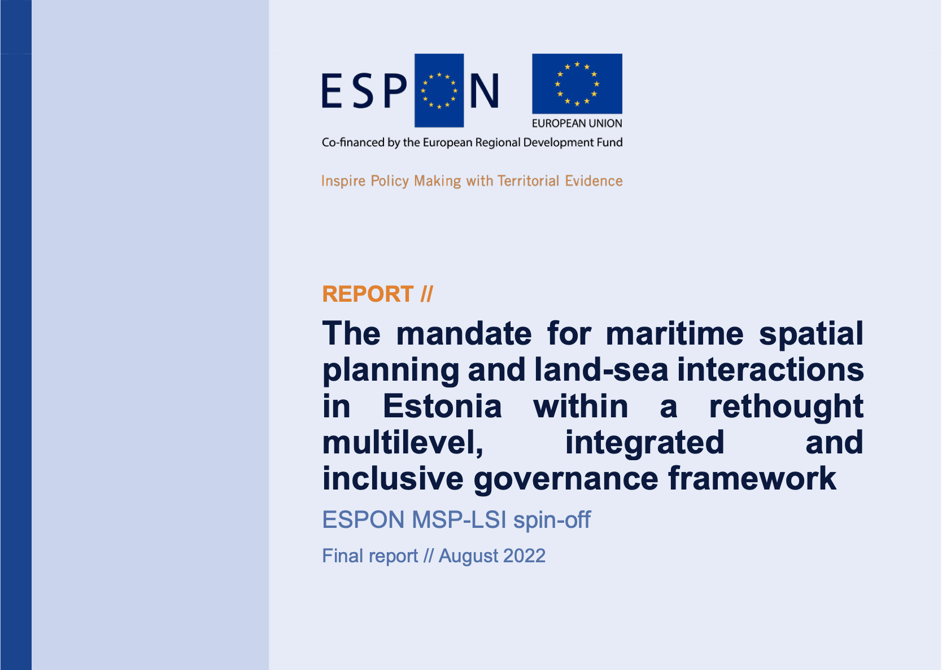
Link: https://www.espon.eu/sites/default/files/attachments/Final%20Report%20MSP-LSI%20Estonia.pdf

Slide 3
Objectives and tasks of the project
Objectives:
Undertake an analysis and characterization of the coastal and maritime planning and land-sea interactions from a multi-level, multi-sectoral and multi-actor perspective, and
outline policy recommendations that could build the basis for comprehensively embedding the maritime spatial planning competences of local and national level into legislation and into formal and informal planning processes.
Specific tasks:
Adopt the MSP-LSI methodological framework, define LSI in Estonian municipalities and a potential mandate for local intervention.
Scope and map LSI through desk research and stakeholder consultations.
Investigate relevant planning frameworks and related legislation to identify best practices that could be transposed to the Estonian case.
Make recommendations for a more inclusive maritime planning framework and inputs for legislative proposals for Estonia.

Slide 4
Land-sea interaction activities
Renewable energy
Mining of mineral resources
Development of ports, piers, slips, quays, berths,
Maritime transport
Regulation of waterborne traffic
Tourism and recreation
Motorised water sports
Non-motorized water sports
Establishing ice roads
Dredging of navigation routes
Dumping of dredged material
Sewage, gas and other pipelines
13. Telecommunication cables
14. Wastewater treatment
15. Land-based industry effluent discharge
16. Agriculture run-off
17. Fishing
18. Aquaculture
19. Other marine living resource exploitation
20 Research and monitoring
21. Nature conservation
22. Conservation of cultural heritage
23. Securing public access to the sea and shore areas
24. Military activities

Slide 5
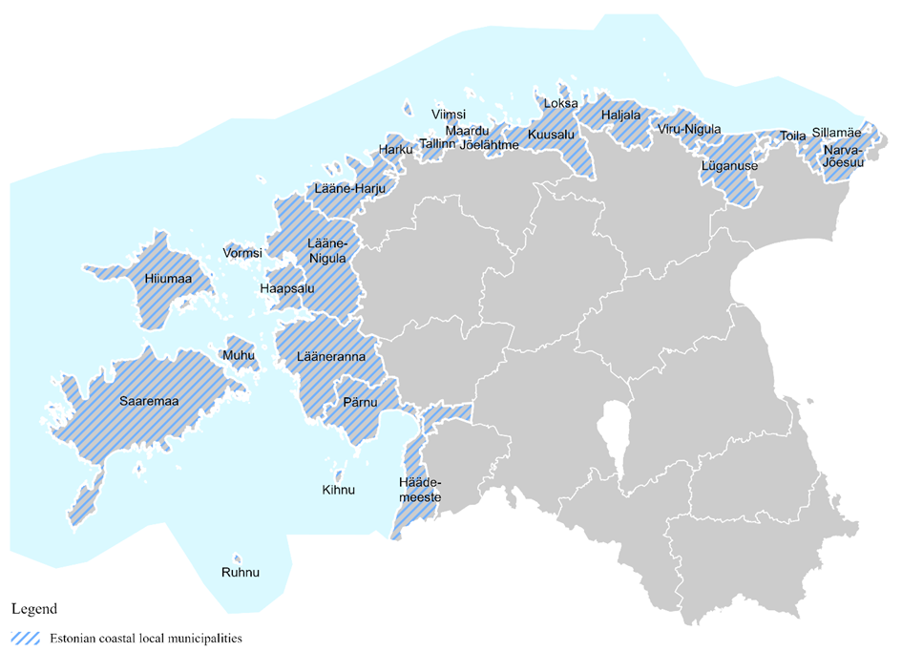
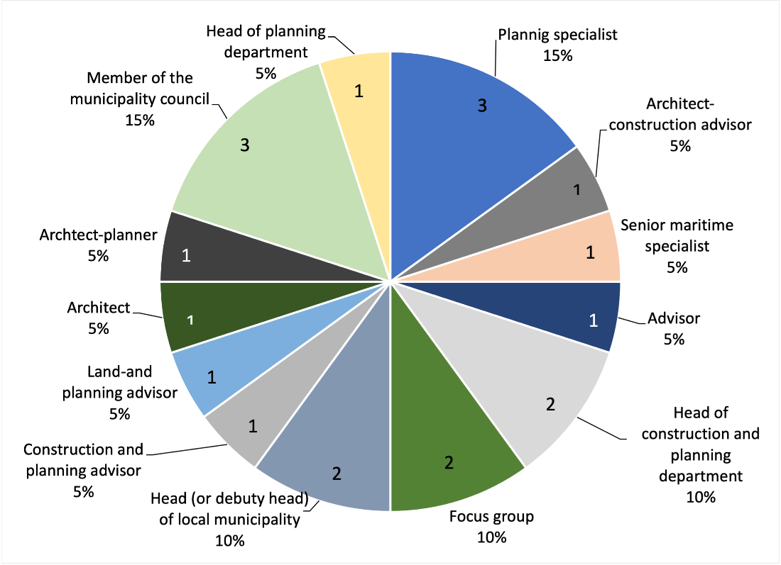
The survey
Survey
Web-based survey, June 2022.
All Estonian municipalities (25) which have a sea border were asked to participate in the survey.
One representative from each municipalities, 20 responses received.
Study area

Slide 6
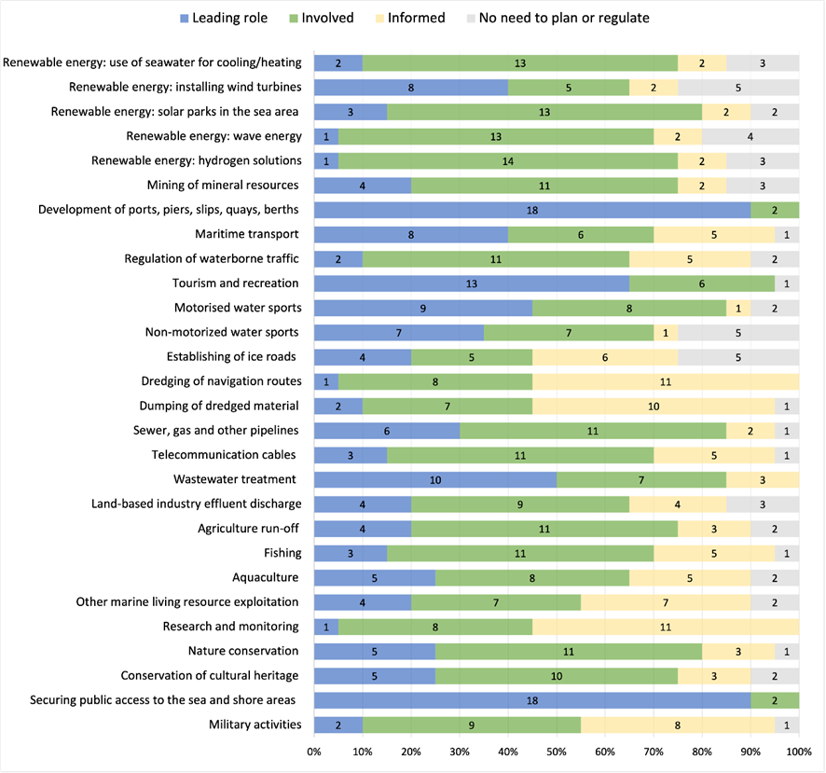
Results
Areas of maritime use that municipalities currently need to plan spatially or were to regulate their activities, and the role each municipality would like to have in these sectors
Leading role in:
development of ports, piers ect. and securing access to the sea and shore areas (18);
tourism and recreation (13);
wastewater treatment (10).

Slide 7
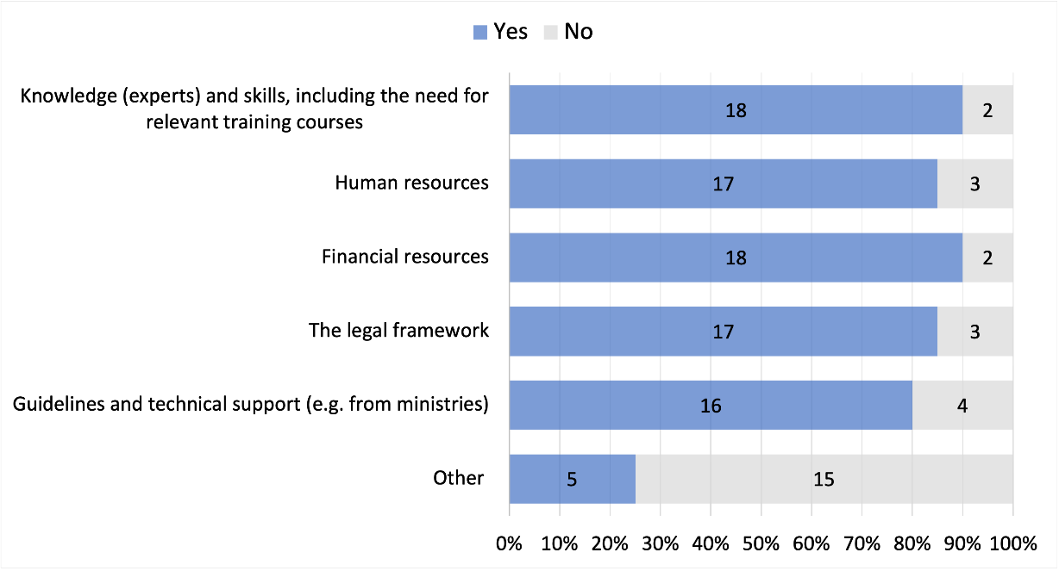
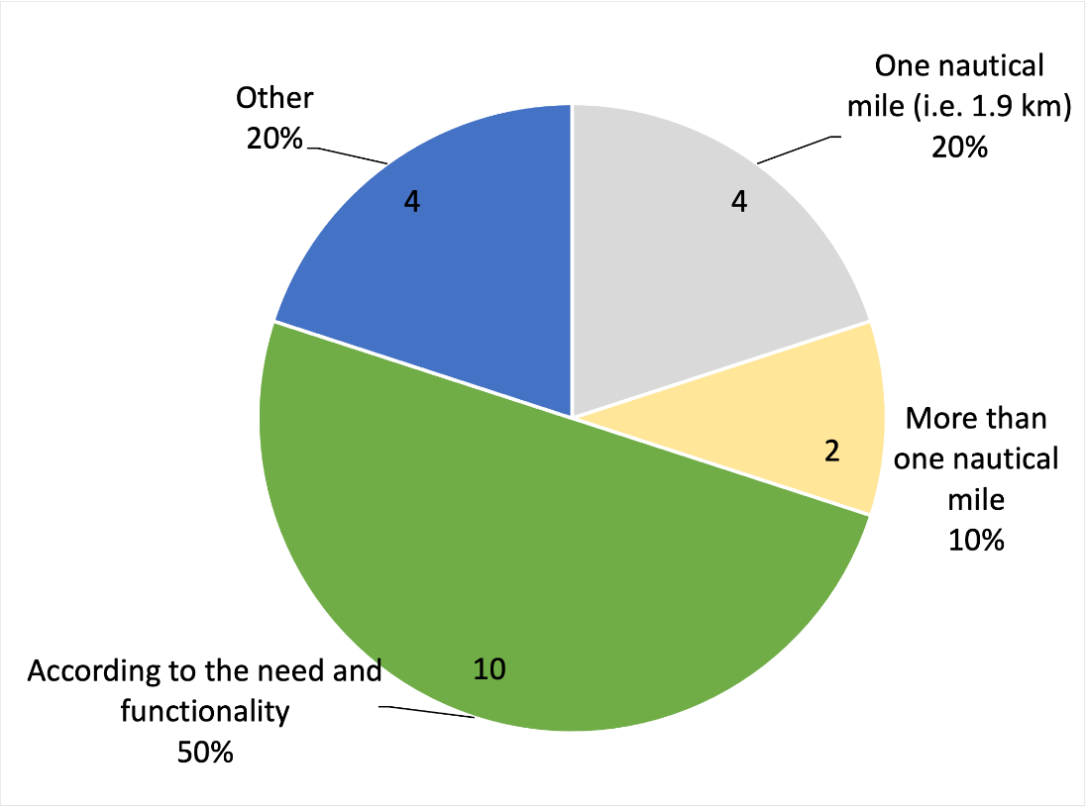
Interests of local governments in planning and regulating maritime areas
17 municipalities are interested, 3 are not.
Distance from the coastline that the local governments would like to have the authority to plan and regulate
Support needs of the local governments for MSP:

Slide 8
Which activity/sector/ aspect is unregulated, or insufficiently or over-regulated by the state in the maritime area?
Some local governments felt that most sectors are rather over-regulated, for example renewable energy and construction of small ports and slips.
There were also views expressed that some aspects are under-regulated, for example securing public access to the shore areas or transferring fuel from ship to ship.
There were also indications that the overall system is fragmented, and some support would be needed from the state (legislative, overall knowledge or financial).
Four local governments did not mention any activities, sectors or aspects that are unregulated or un-der/over-regulated.

Slide 9
Specific suggestions for changing some of the most important legal provisions for the use of maritime space in their local government
Some municipalities felt that they should have more rights (legally as well as more say in decision-making), adequate resources and sufficient flexibility. Overall communication and cross-sectoral cooperation could be improved.
Few municipalities mentioned wind farms (less in numbers and farther away from the coast, impact on fishing sector).
Some problematic sectors or activities were highlighted, where changes need to be made:
nature conservation laws, the military sector, water traffic, transshipment and bunkering, hauling routes, the obligation to apply for environmental permits for the constructions and construction in the coastal areas, granting building rights, ensuring public access to the coast, control in the fishing sector (equipment), agriculture and putting attractions at sea.
Five municipalities did not have any specific suggestions.
Notes:
Some specific suggestions were proposed

Slide 10
Main knowledge gaps for furher research
What are the specific needs for larger than 1 nm zone expansion of the planning and regulative powers of local governments, under which conditions/situations these occur, and whether these can be generalised for legislative purposes?
Identifying fields of maritime uses that should be left centrally planned and regulated at a national level. As a basis for the discussion, a thorough analysis of existing practices (plan implementation) in countries with similar administrative and planning systems is needed.
Detailed identification of changes in national regulations, together with proposing text edits for the regulations which are too rigid from the local perspective.
Proposing ways and mechanisms to resolve the high-priority issues associated with MSP, such as coastal and species protection and decentralised renewable energy production and storage solutions.

Slide 11
Recommendations
Involving local governments from the initial stages of development and more effectively in the process of MSP.
Establishing appropriate communication mechanisms between different stakeholders
Expanding the planning and regulative powers of local governments to coastal waters, as a rule, 1 nm from the shoreline.
There are several fields in maritime uses that should be left centrally planned and regulated at a national level (e.g military issues, nature and heritage protection, fishing, and large renewable energy projects).
As a start only larger towns can be considered to have offered an opportunity to carry out maritime planning. Incremental improvement and addressing the lessons learned will allow moving to smaller units.
To ensure appropriate training and allocation of funding to increase the skills of local authorities. Establishing a specific training program for relevant employees and leadership in coastal municipalities is required.

Slide 12
Thank you for your attention

