Slide 1
Technical solutions and the sea
Prof. Ivo Palu Department of Electrical Power Engineering and Mechatronics

Slide 2
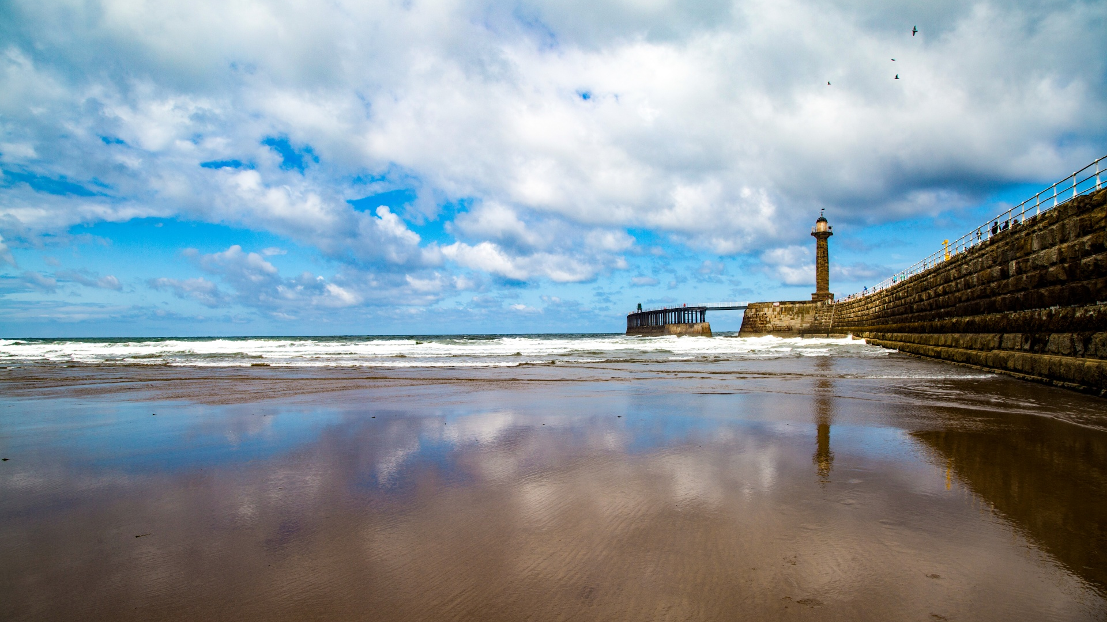

Slide 3
a list of methods to generate electricity from the sea
Tidal Energy
Tidal energy is harnessed by using underwater turbines that capture the kinetic energy of rising and falling tides.
Wave Energy
Wave energy converters (WECs) move with the motion of ocean waves, and this movement is converted into electricity.
Ocean Thermal Energy Conversion (OTEC)
OTEC systems use the temperature difference between warm surface waters and cold deep waters to generate electricity through a heat engine.
Offshore Wind Farms
Wind turbines placed in offshore locations utilize strong, consistent sea winds to generate electricity.

Slide 4
a list of methods to generate electricity from the sea
Salinity Gradient Power
This method exploits the difference in salt concentration between seawater and freshwater to generate electricity through ion-exchange membranes.
Underwater Piezoelectric Generators
These devices generate electricity when subjected to pressure changes caused by underwater movements or waves.
Hydrokinetic Energy
Submerged rotors or turbines capture the energy from water flow in rivers, estuaries, and tidal areas.
Magnetostrictive Materials
These materials generate electricity when subjected to mechanical stress underwater, such as from wave motion.

Slide 5
a list of methods to generate electricity from the sea
Underwater Currents
Turbines or underwater kites capture the kinetic energy of ocean currents to produce electricity.
Osmotic Power (Pressure retarded osmosis)
It generates electricity by utilizing the pressure difference created when freshwater and seawater are brought together through a semi-permeable membrane.
Floating Solar Farms
Solar panels mounted on floating platforms on the sea's surface generate electricity using sunlight.
Algae Biofuels
Algae can be grown in the ocean and converted into biofuels that are used to produce electricity.

Slide 6
What is suitable for us?
Tidal Energy
Tidal energy is harnessed by using underwater turbines that capture the kinetic energy of rising and falling tides.
Wave Energy
Wave energy converters (WECs) move with the motion of ocean waves, and this movement is converted into electricity.
Ocean Thermal Energy Conversion (OTEC)
OTEC systems use the temperature difference between warm surface waters and cold deep waters to generate electricity through a heat engine.
Offshore Wind Farms
Wind turbines placed in offshore locations utilize strong, consistent sea winds to generate electricity.

Slide 7
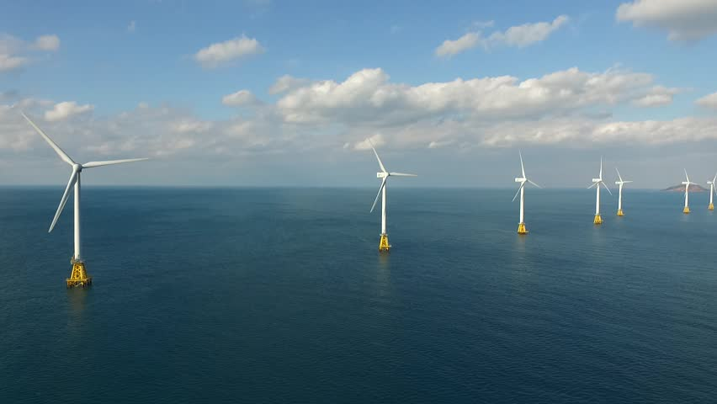

Slide 8
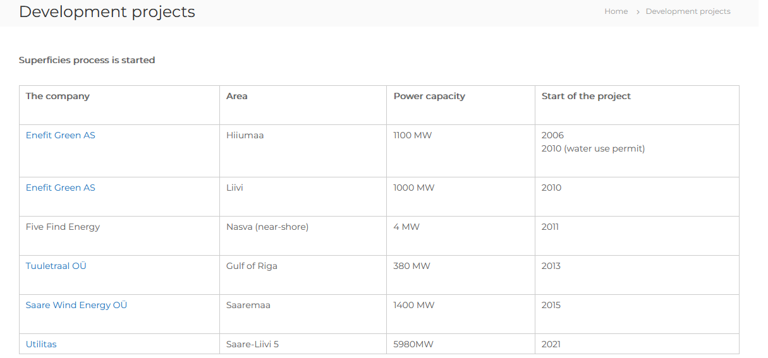
Estonian Off-shore „big“ plan
Total 9000 MW+

Slide 9
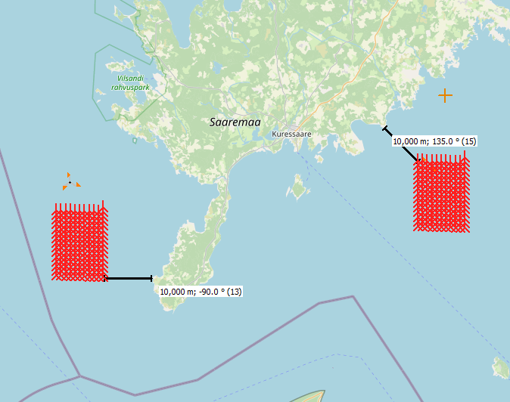
Ways to install 1 GW Offshore wind park
Cases:
166 WTG x 6MW. Regular height of hub 119 m. Distance 6.2D.
166 WTG x 6MW. Extended height of hub 169 m. Distance 6.2D (increasing height)
166 WTG x 6MW. Regular height of hub 119 m. Distance 8D (increasing distance between WTGs)
138 WTG x 7.2MW. Regular height of hub 119 m. Distance 6.2D (decreasing number of WTGs)
Calculations done by Victor Astapov, PhD, Department of Electrical Power Engineering and Mechatronics

Slide 10
How it affects on energy production and costs
Increasing the distance between wind turbine generators (WTGs) leads to an increase in generation. However, this also results in higher costs for the cabling system.
Constructing taller wind turbine towers harnesses faster wind speeds, leading to increased energy production. Nevertheless, the costs associated with tower construction and installation are also higher.
Placing wind parks farther from the shore enhances energy generation potential. Nevertheless, this approach escalates the expenses related to the transmission system and energy losses.
The utilization of wind turbines with larger installed capacities not always enables higher energy production, but reduces cabling costs. However, the initial costs of these turbines are also higher and efficiency depends on wind speed distribution in the area.

Slide 11
In simple words on 1 GW Example
Case | 1 | 2 | 3 | 4
WTG capacity, MW | 6 | 6 | 6 | 7.2
WTG Height of tower, m | 119 | 169 | 119 | 119
Number of WTG,s | 166 | 166 | 166 | 138
Distance D | 6.2 | 6.2 | 8 | 6.2
Total installed capacity, MW | 996 | 996 | 996 | 993.6
Mean speed at the hub, m/s | 9 | 9.3 | 9 | 9
Annual generation, TWh | 3,98 | 4,1 | 4,1 | 3,6
COE, EUR/MWh | 50,86 | 50,73 | 49,47 | 53,63
LCOE, EUR/MWh | 59,78 | 59,73 | 58,14 | 62,96
Collector cables total length, km | 165 | 165 | 170 | 137
Costs of the project, MEUR | 4053 | 4161 | 4064 | 3928
Costs M€ per MW | 4,069 | 4,178 | 4,081 | 3,954

Slide 12
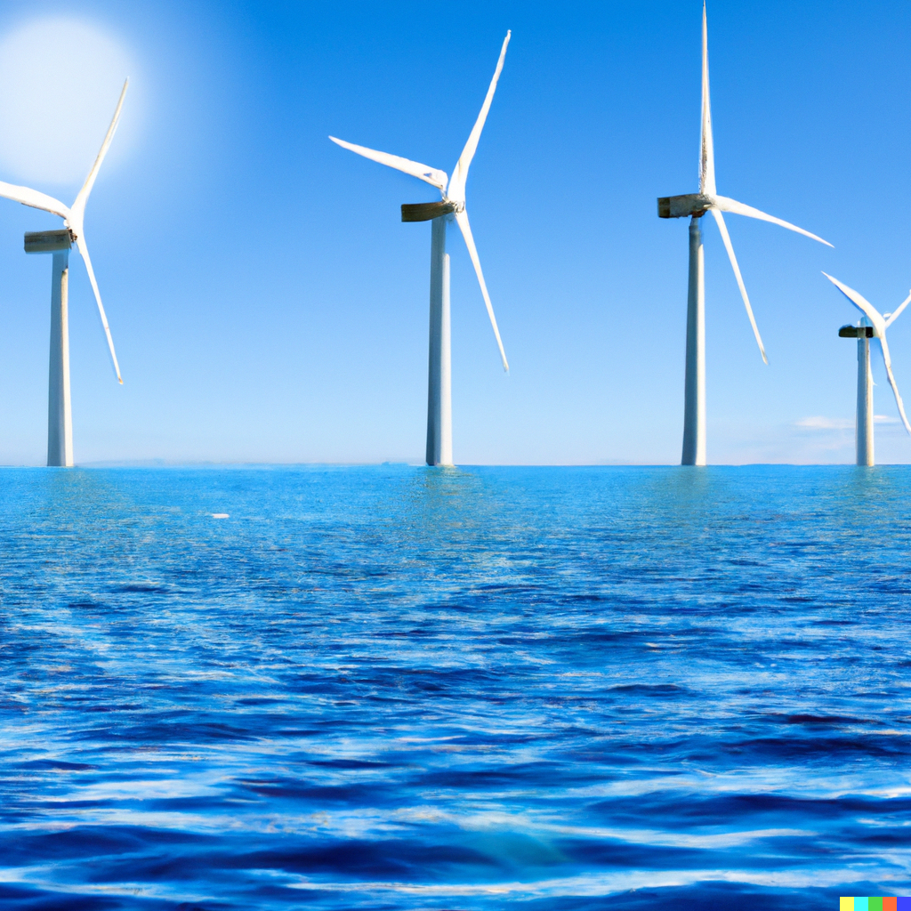
In simple words on 1 GW Example. Concussion
An increase in hub height has shown the most significant improvements. This change results in minimal cost increases while boosting generation capacity and leading to the best Levelized Cost of Energy (LCOE).
The size and parameters of WTGs should be chosen meticulously, considering factors like wind speed distribution and the WTG capacity curve.
When planning the positioning of WTGs, it's essential to consider wind speed direction.
The outcome of a wind park is highly dependent on the mean wind speed in the area

Slide 13
What would be if Estonia has 7GW installed capacity of offshore wind?
1 GW installed capacity $≈$328 GWh/month (or x 12 = 3,9 TWh)
7 GW installed capacity $≈$ 2296 GWh/month (or x 12 = 27,5 TWh)
In July 2023 300 MW generated 54 GWh

Slide 14
AITÄH!
www.facebook.com/ttueem
www.taltech.ee/elektroenergeetika-ja-mehhatroonika-instituut

