Slide 1

Overview of the European
blue economy
Jörn Schmidt, Chair Science Committee
@j_o_schmidt
@ICES_ASC

Slide 2
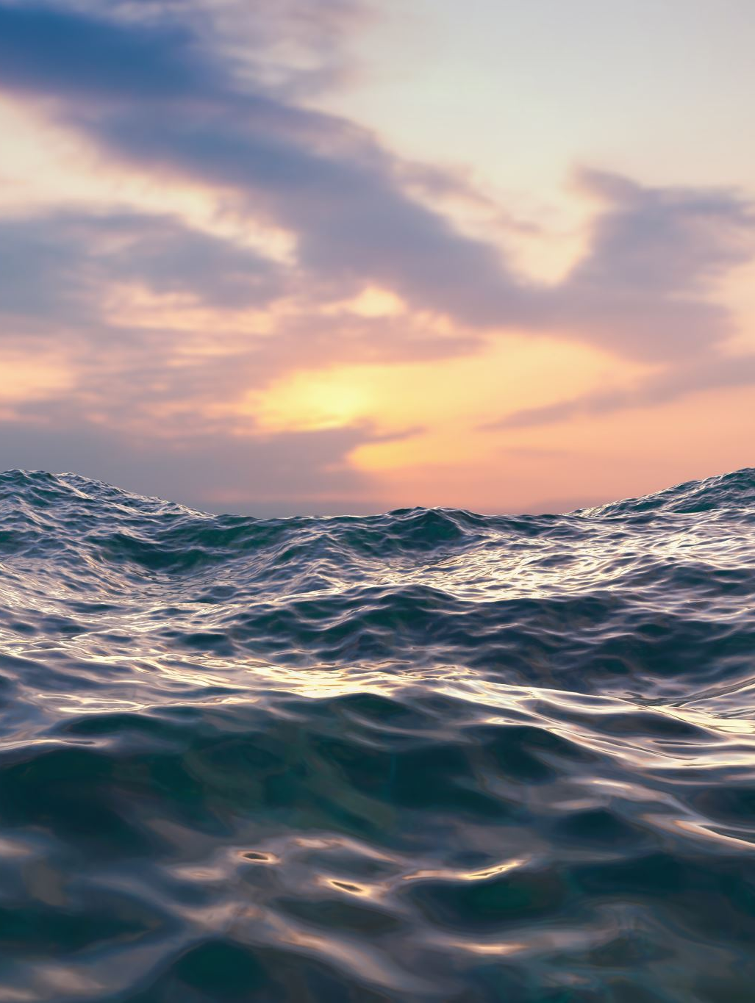

What is “Blue Economy“?
„Sustainable use of ocean resources for economic growth, improved livelihoods, and jobs while preserving the health of ocean ecosystem.“ (World Bank)
„An emerging concept which encourages better stewardship of our ocean or 'blue' resources.“ (The Commonwealth of Nations)
„All economic activities related to oceans, seas and coasts. It covers a wide range of interlinked established and emerging sectors.“ (European Commission)

Slide 3
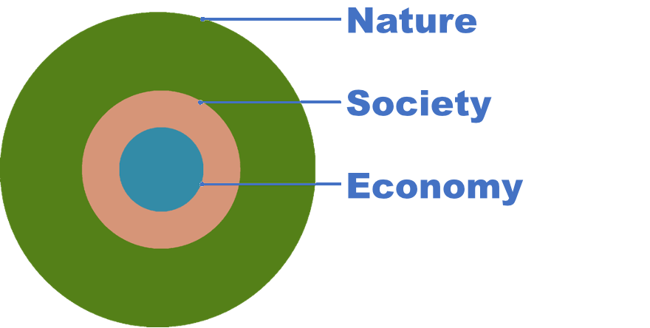
The three pillars of sustainability
(nach Daly 1996, Griggs et al. 2013)
...taking into account knowledge and uncertainty of abiotic, biotic and human components and their interactions...
...balance diverse societal objectives...
FAO Ecosystem Approach to Fisheries 2003

Slide 4
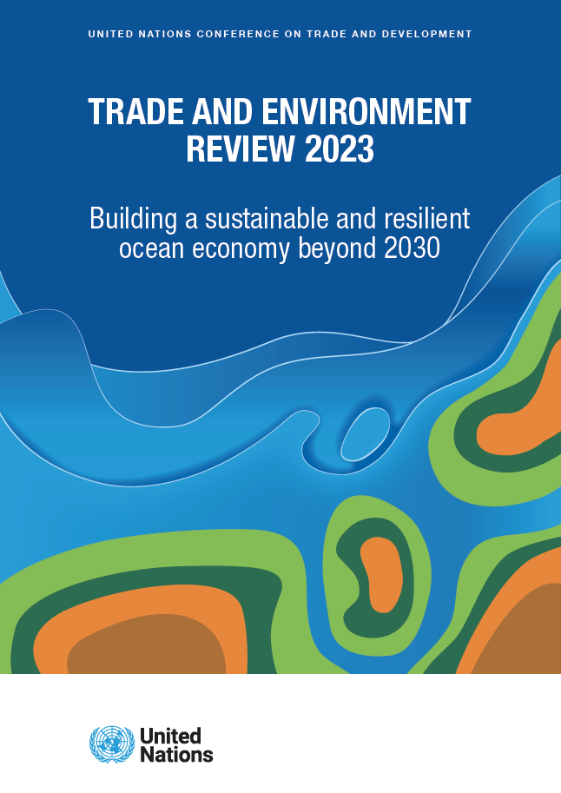
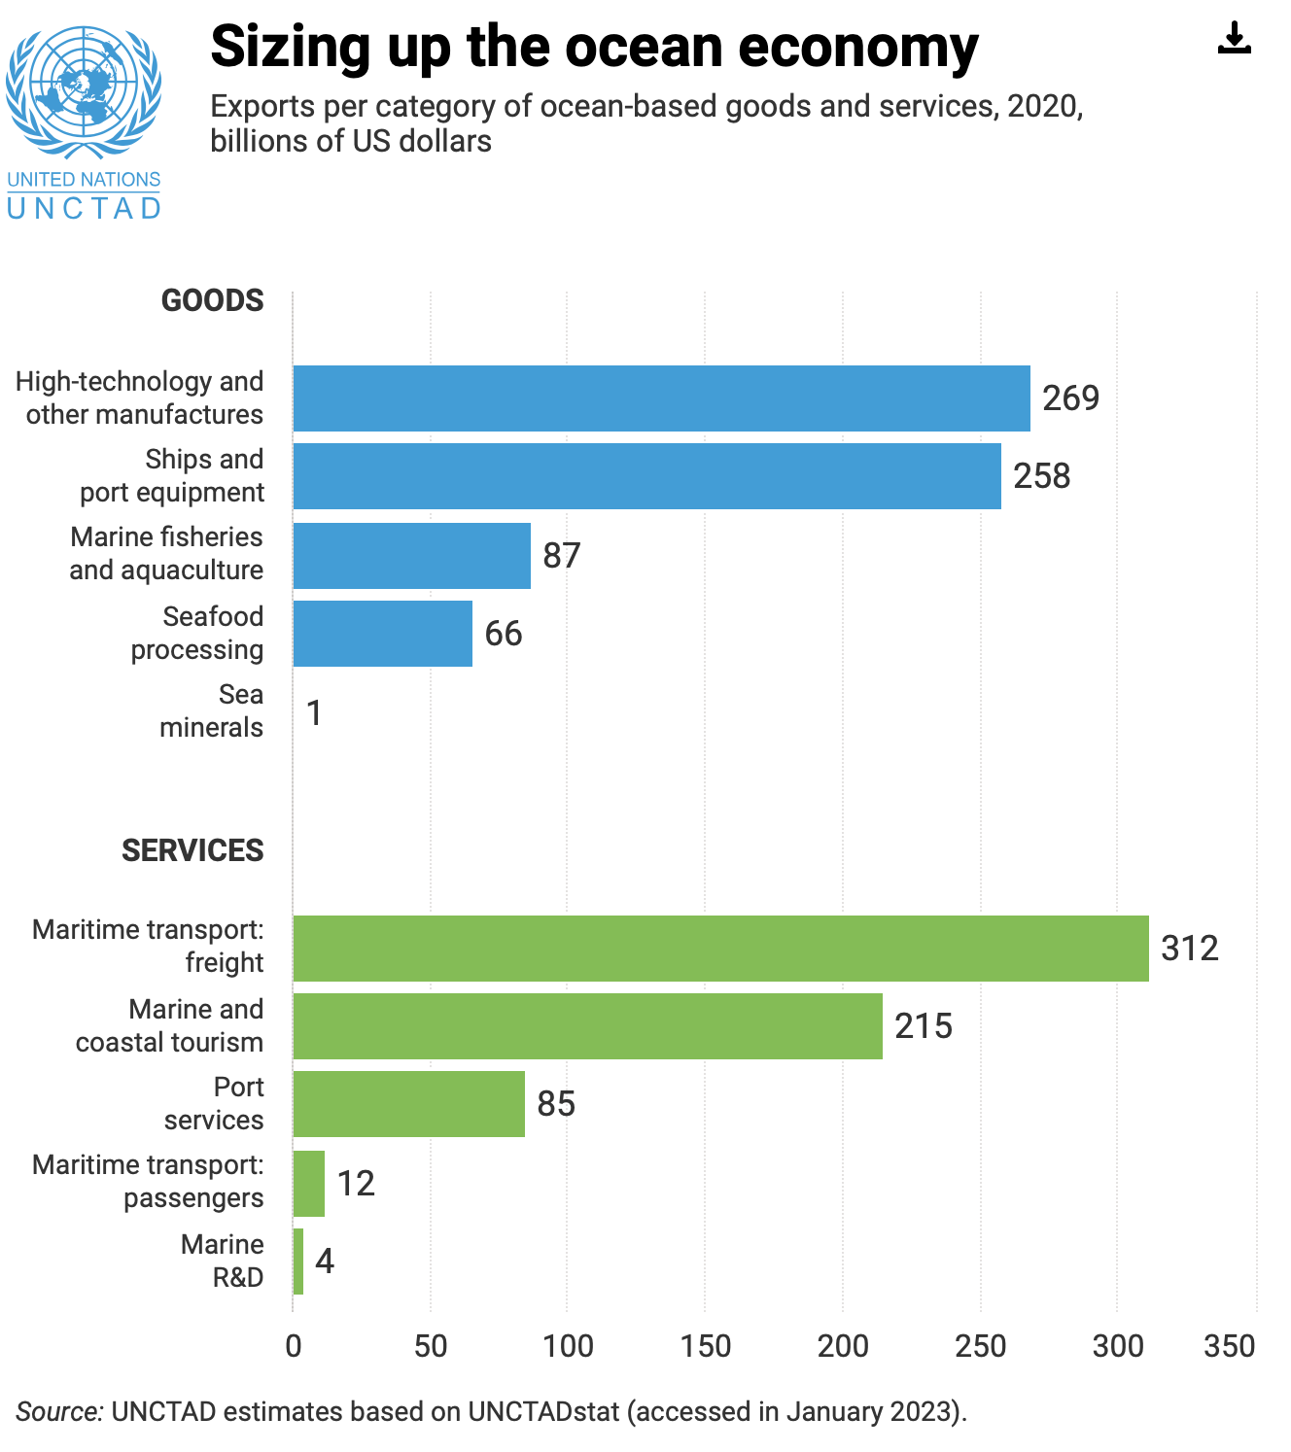
In 2020, the export value of the ocean economy was $1.3 trillion, with exports of ocean-based goods estimated to be $681 billion, and exports of ocean-based services $628 billion
https://unctad.org/system/files/official-document/ditcted2023d1_en.pdf

Slide 5
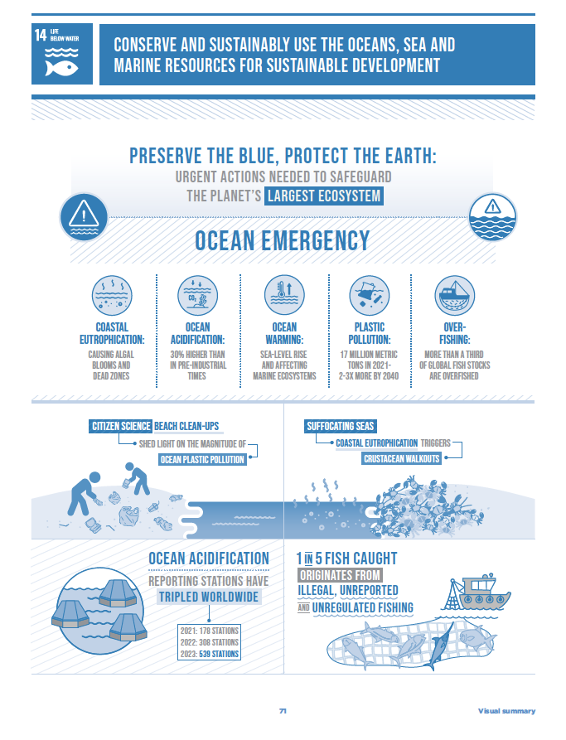
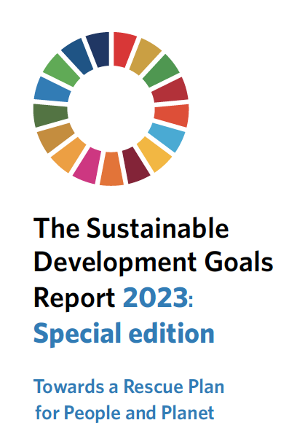
https://unstats.un.org/sdgs/report/2023/

Slide 6
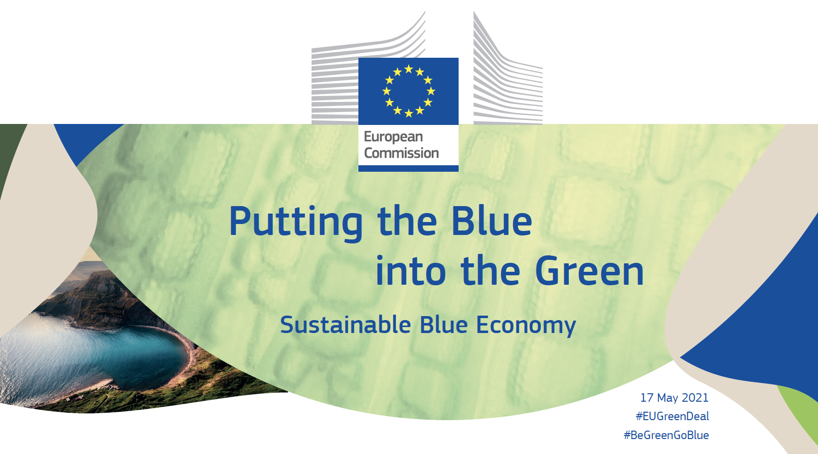
Transforming the EU's Blue Economy for a Sustainable Future
https://eur-lex.europa.eu/legal-content/EN/TXT/PDF/?uri=CELEX:52021DC0240

Slide 7
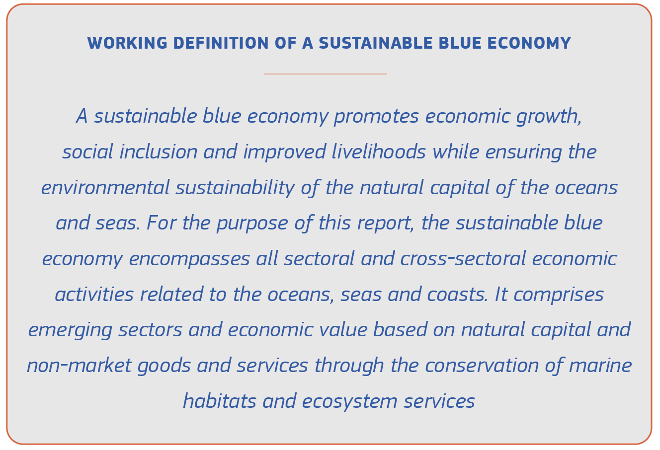
Sustainability criteria for the blue economy – Main Report
doi.org/10.2826/399476

Slide 8
“The challenge of climate change only exacerbates the existing pressures coming from marine pollution, unsustainable resource use or illicit activities. At the same time, the blue economy offers opportunities for sustainable economic development. So, I am convinced that we can restore our marine environment while also bringing benefits to our coastal communities, and the economy at large.”
All blue economy sectors including fisheries, aquaculture, coastal tourism, maritime transport, port activities and shipbuilding will have to reduce their environmental and climate impact. Tackling the climate and biodiversity crises requires healthy seas and a sustainable use of their resources to create alternatives to fossil fuels and traditional food production.
Transitioning to a sustainable blue economy requires investing in innovative technologies. Wave- and tidal energy, algae production, development of innovative fishing gear or restoration of marine ecosystems will create new green jobs and businesses in the blue economy.
Virginijus Sinkevičius, European Commissioner for Environment, Oceans and Fisheries

Slide 9
Established Blue Economy Sectors
Marine living resources
Marine non-living resources
Marine renewable energy
Port activities
Shipbuilding and repair
Maritime transport
Coastal tourism

Slide 10

Established Blue Economy Sectors
Marine living resources
Marine non-living resources
Marine renewable energy
Port activities
Shipbuilding and repair
Maritime transport
Coastal tourism
Public Sector (research, military operations, coastal defence, etc.)

Slide 11
Emerging Blue Economy Sectors
Ocean renewable energies
Blue biotechnology
Over the past ten years, tidal stream and wave devices - on different scales - have been tested in European waters. However, only a few examples can be found today of ocean energy systems in operation.
Considerable progress is needed - in research, development, demonstration and validation of the technology - for this sector to realise its potential contribution to energy supply, industrial leadership, economic growth and mitigation of climate change.
The emerging blue bioeconomy and biotechnology sectors look at groups of marine organisms that until now often have been ignored for commercial exploitation.
This includes microorganisms (microalgae, bacteria and fungi), algae and invertebrates (e.g. starfish, sea cucumbers, sea urchins)
The blue bioeconomy turns aquatic biomass into food, feed, nutraceuticals, pharmaceuticals, cosmetics, energy, packaging, clothes and much more.

Slide 12
Some definitions:
Gross Added Value: the measure of the total value of goods and services produced in an economy (area, region or country) or by a specific (maritime) sector.
Employment: Either the number of individual people employed in a specific (maritime) sector or the number of Full Time Equivalents (FTEs).

Slide 13
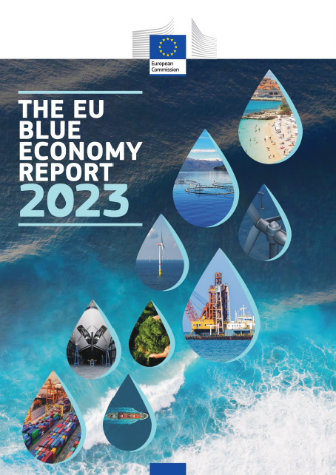
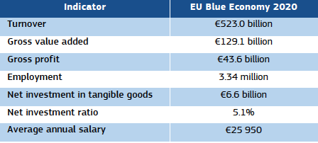
Status of the EU Blue Economy
Notes: Turnover is calculated as the sum of the turnover in each sector; it may lead to double counting along the value chain. Nominal values. Direct impact only. Net investment excludes Maritime transport and Coastal tourism. Net investment ratio is defined as net investment to GVA.
Source: Eurostat (SBS), DCF and Commission Services.
European Commission (2023). The EU Blue Economy Report. 2023.
Publications Office of the European Union. Luxembourg.

Slide 14
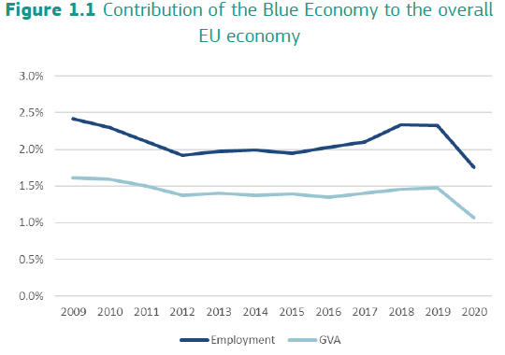
Status of the EU Blue Economy
European Commission (2023). The EU Blue Economy Report. 2023.
Publications Office of the European Union. Luxembourg.

Slide 15
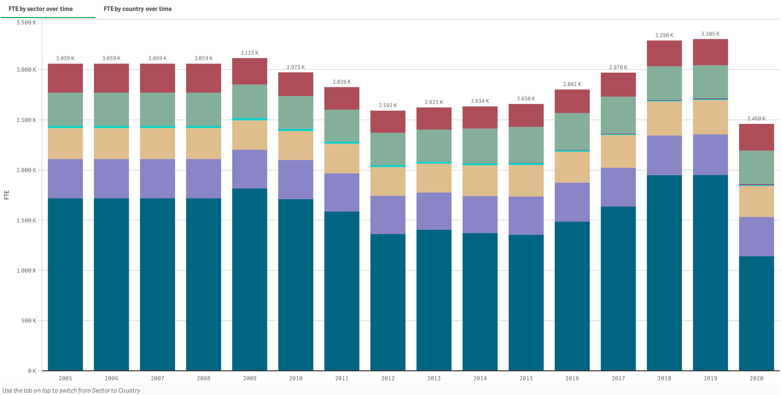
Shipbuilding and Repair
Ports Activities
Ocean Energy
Maritime Transport
Non Living Resources
Living Resources
Coastal Tourism
3.341 million people employed in 2020
https://blue-economy-observatory.ec.europa.eu/depth-analytical-tool_en

Slide 16
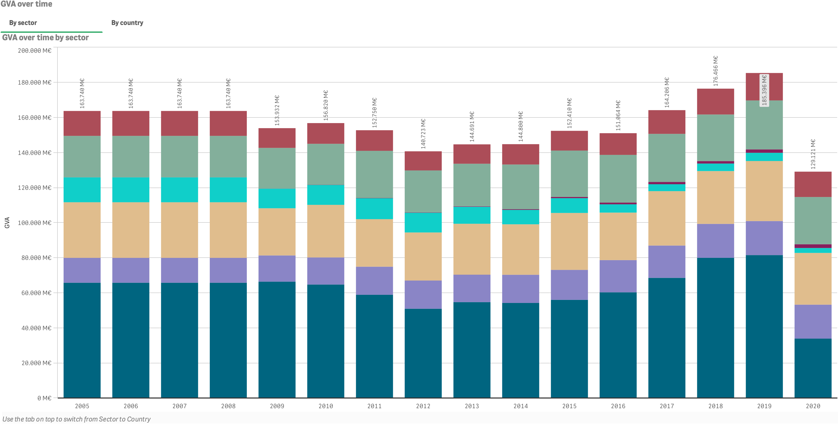
Shipbuilding and Repair
Ports Activities
Ocean Energy
Maritime Transport
Non Living Resources
Living Resources
Coastal Tourism
3.341 million people employed in 2020
https://blue-economy-observatory.ec.europa.eu/depth-analytical-tool_en

Slide 17
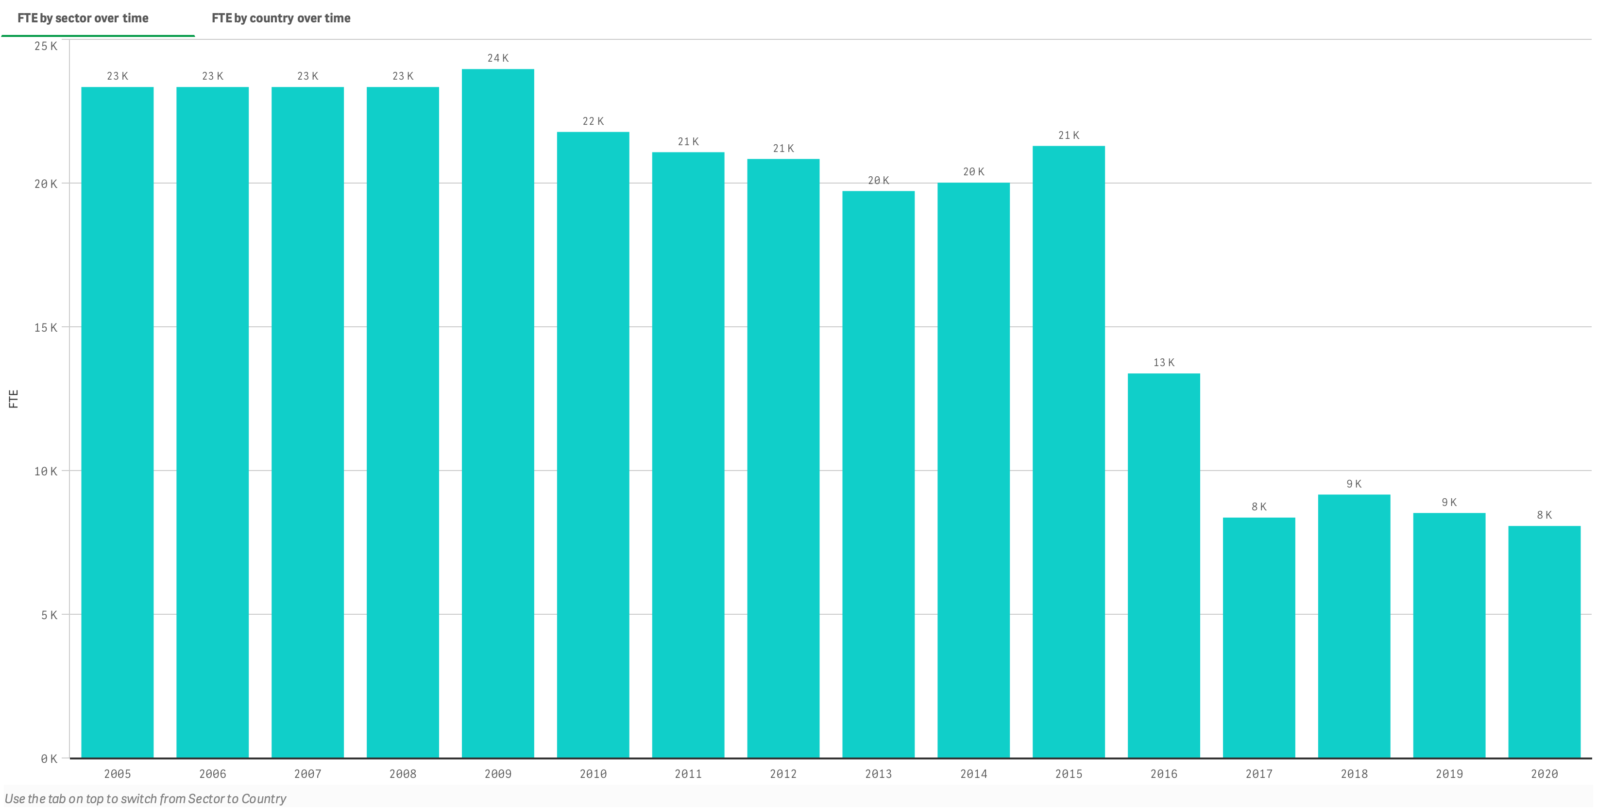
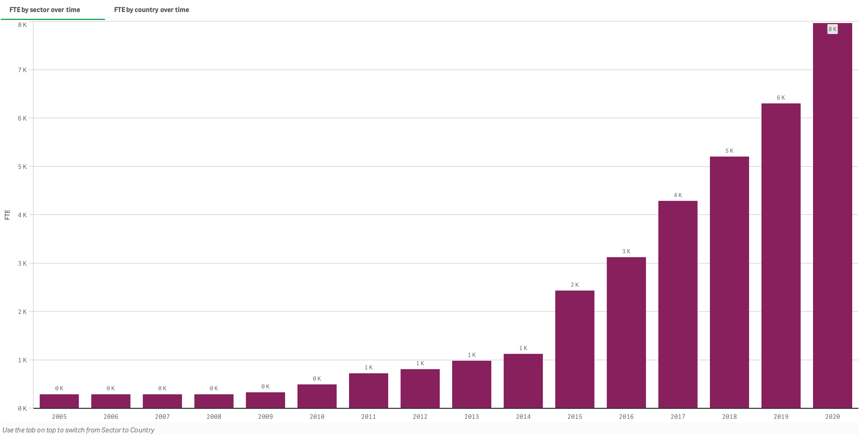
Non-Living Resources
Ocean Energy

Slide 18
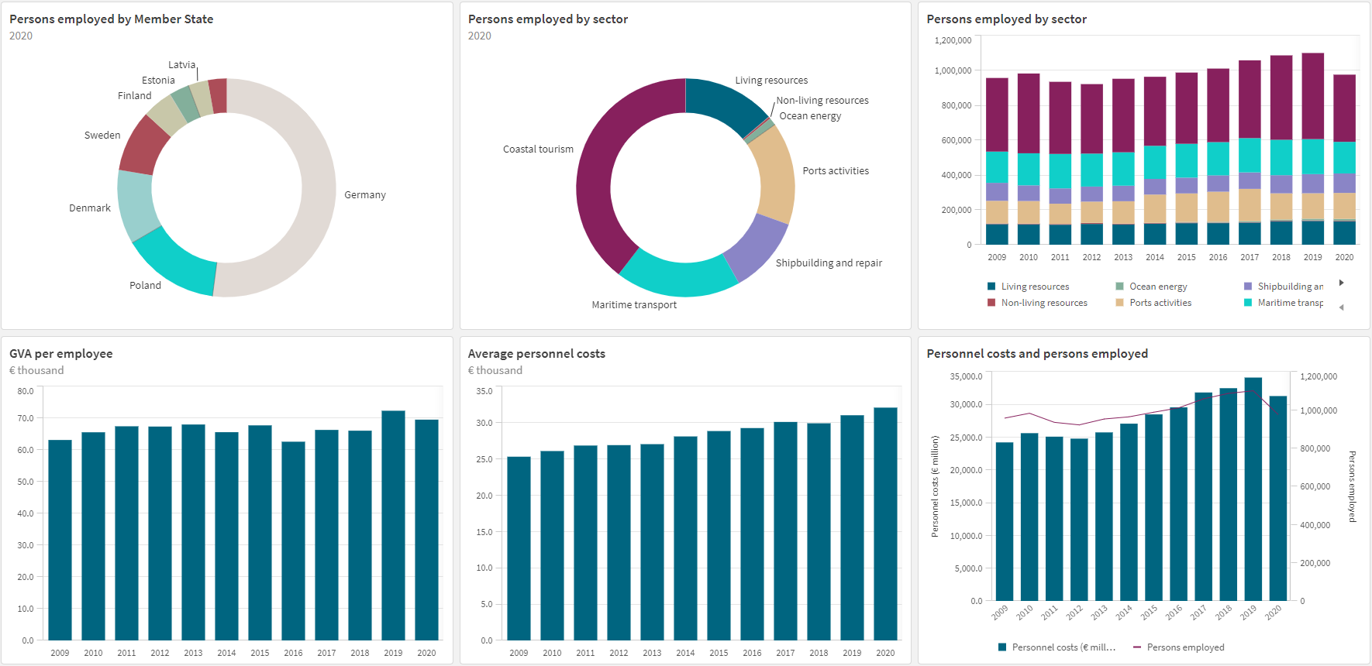

Slide 19
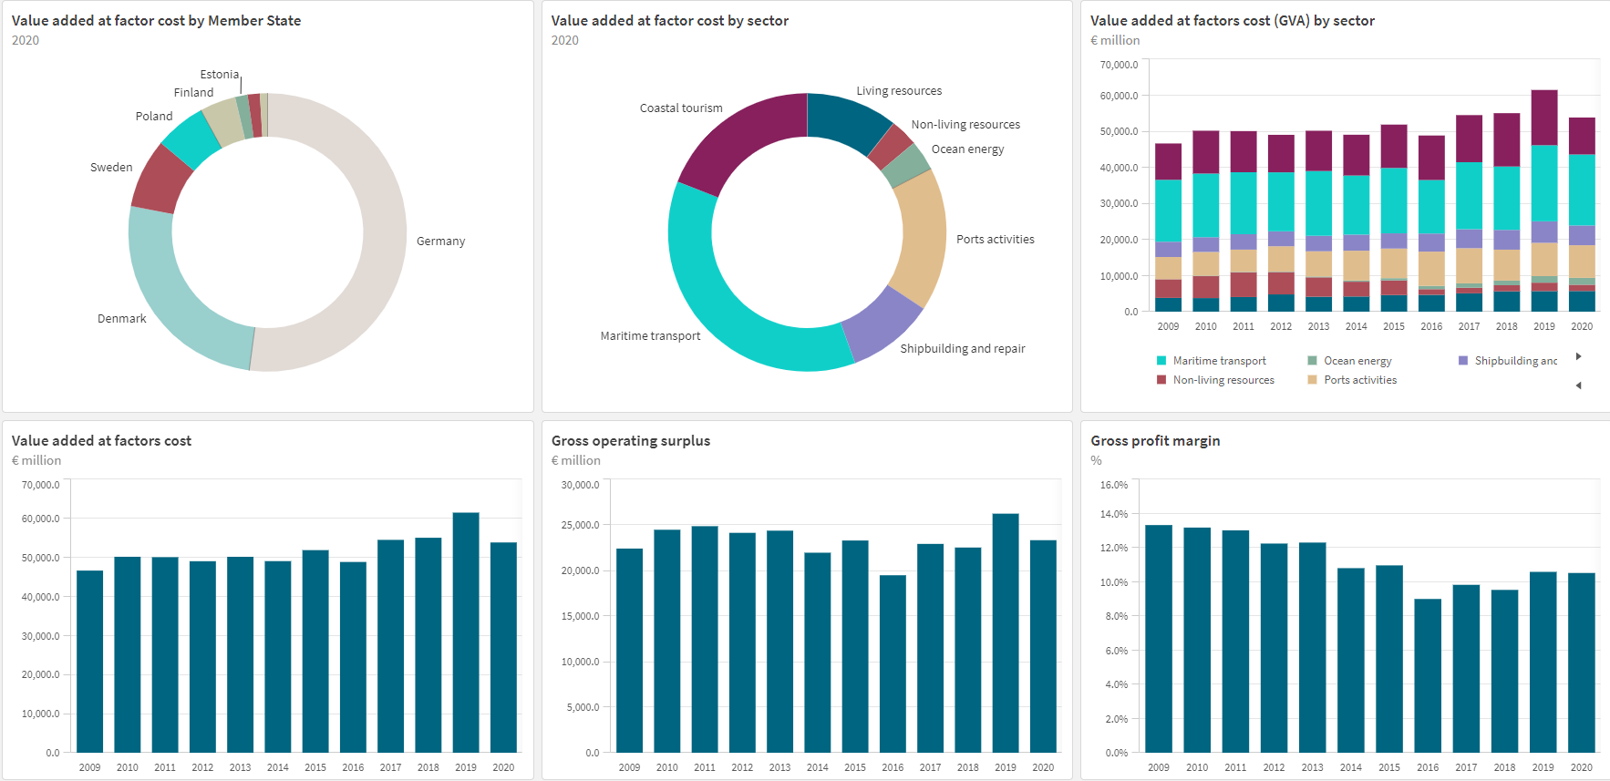

Slide 20
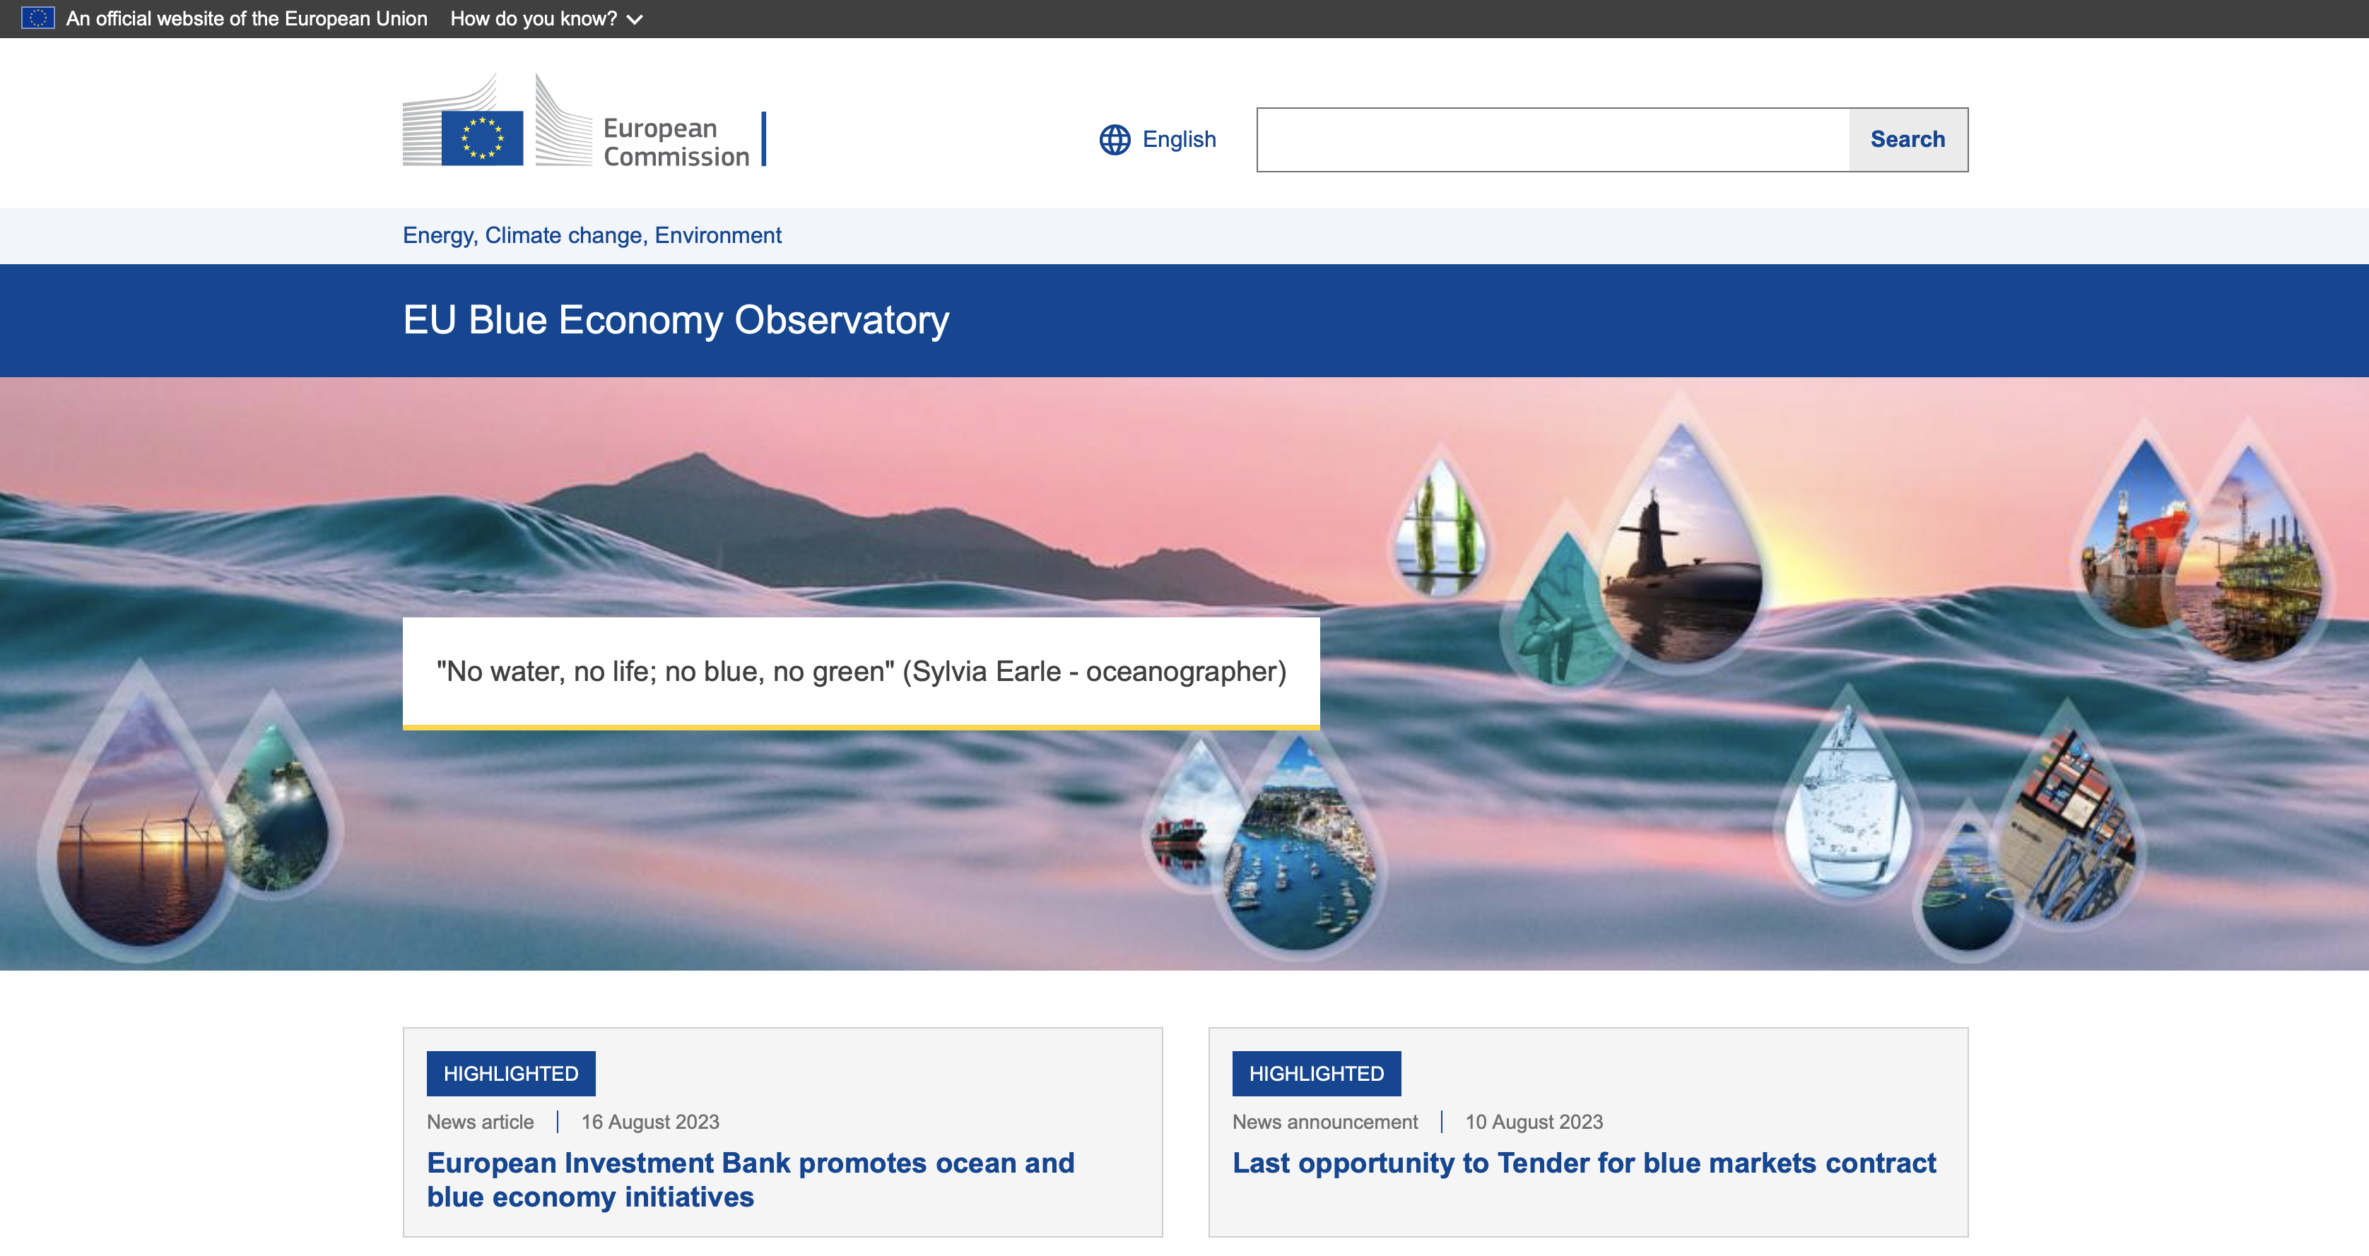
https://blue-economy-observatory.ec.europa.eu/index_en

Slide 21

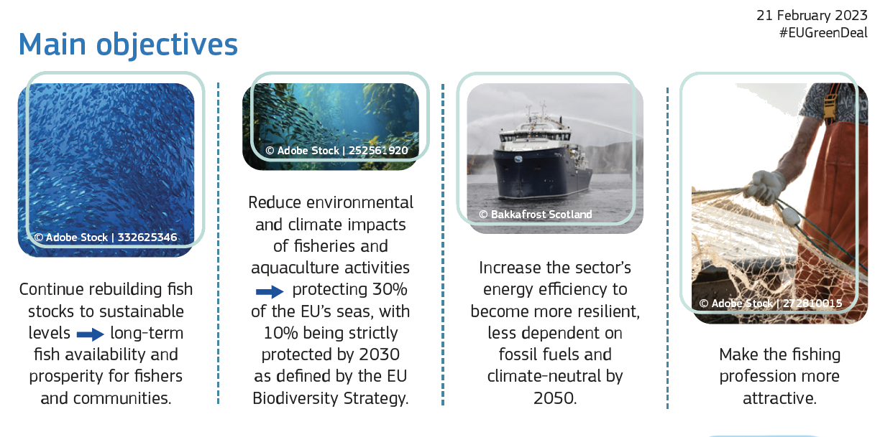
Marine living resources
Actions for sustainable and resilient fisheries, aquaculture and marine ecosystems

Slide 22
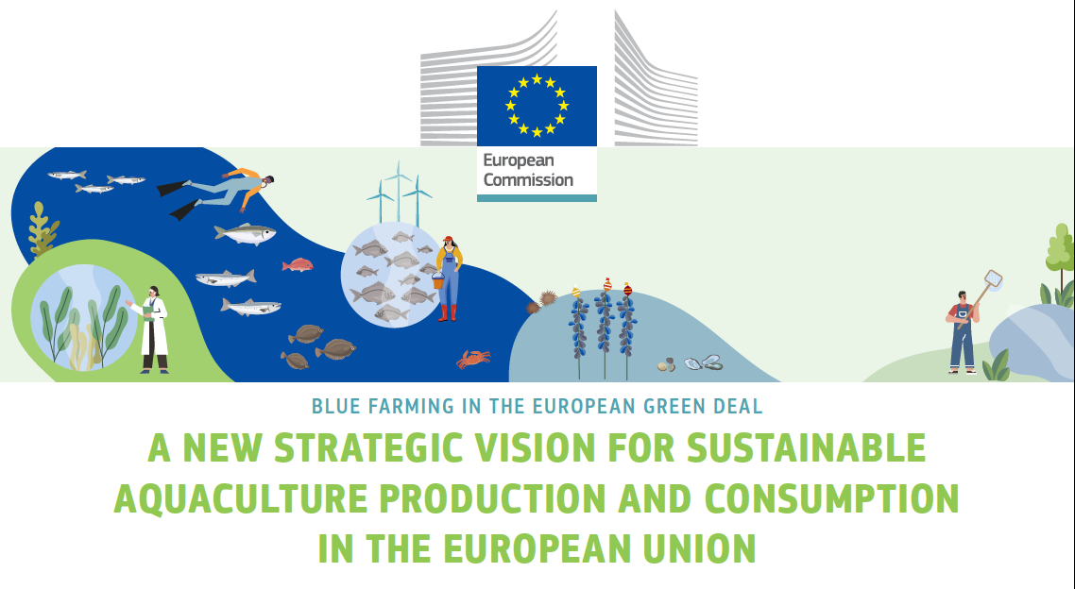
Marine living resources
Achieving this vision will require addressing different challenges and opportunities of the EU aquaculture sector in order to reach the following inter-related objectives:
(1) building resilience and competitiveness;
(2) participating in the green transition;
(3) ensuring social acceptance and consumer information;
and (4) increasing knowledge and innovation.
https://eur-lex.europa.eu/resource.html?uri=cellar:bab1f9a7-b30b-11eb-8aca-01aa75ed71a1.0022.02/DOC_1&format=PDF

Slide 23

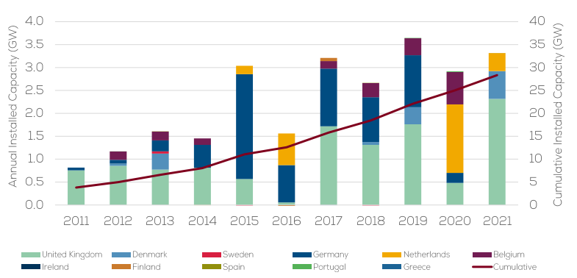
Marine renewable energy
Marine renewable development (including wind, wave and tidal) has been steadily developing in Europe and increasingly globally over the last decade (Fig. 1)
The current strives to increase the offshore installations, including plans for energy islands, will likely accelerate this development.
EU Objectives are 60 GW until 2030 and 300 GW until 2050!
Cumulative and annual offshore wind installations 2010-2021 (source: WindEurope)
https://eur-lex.europa.eu/legal-content/EN/TXT/PDF/?uri=CELEX:52020DC0741

Slide 24
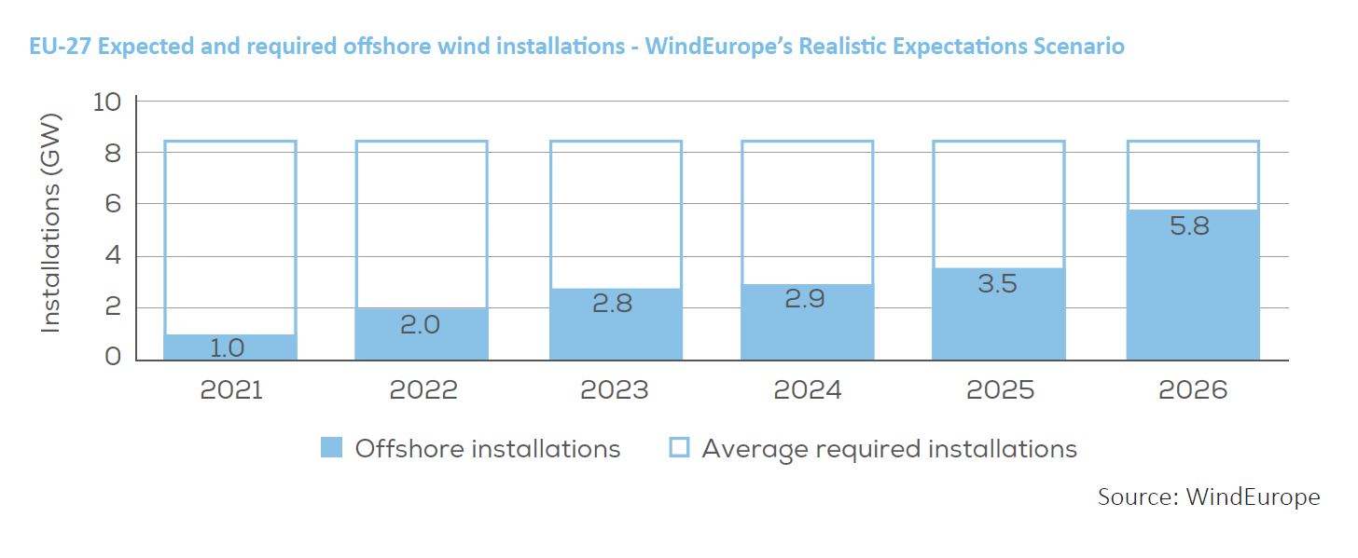
Marine renewable energy

Slide 25

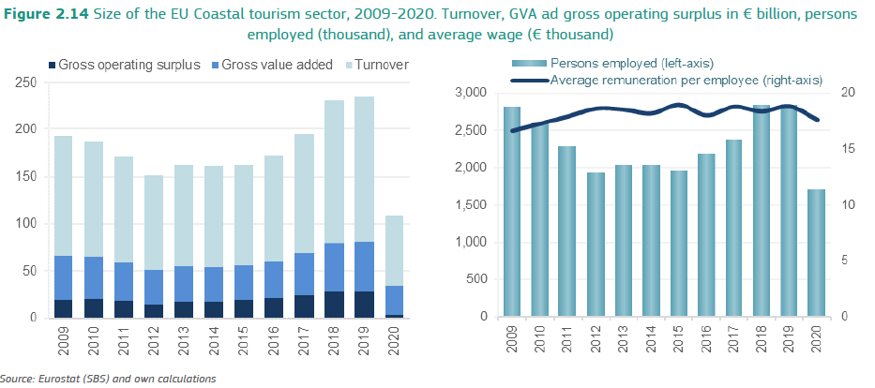
Coastal Tourism

Slide 26
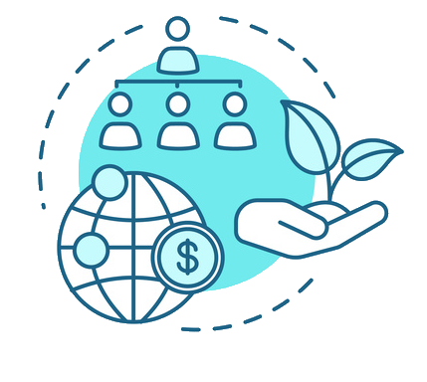
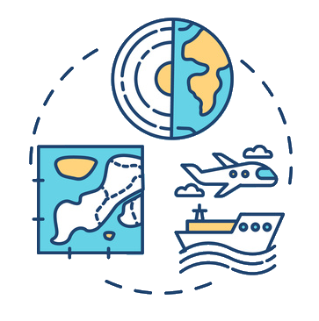
Research Needs
Effects of maritime activities (environmental impacts, sustainable use, emissions)
Cumulative effects
Social and economic benefits
Use of space, co-location of activities
Ecosystem Based Managament
Maritime Spatial Planning

Slide 27
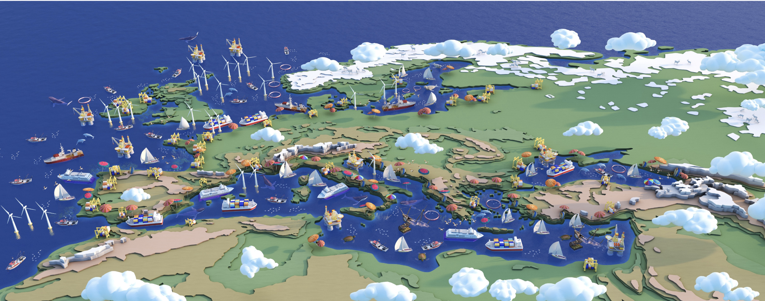
Maritime Spatial Planning (MSP)
„a process by which the relevant Member State’s authorities analyse and organise human activities in marine areas to achieve ecological, economic and social objectives.
Directive 2014/89/EU of the European Parliament and of the Council

Slide 28
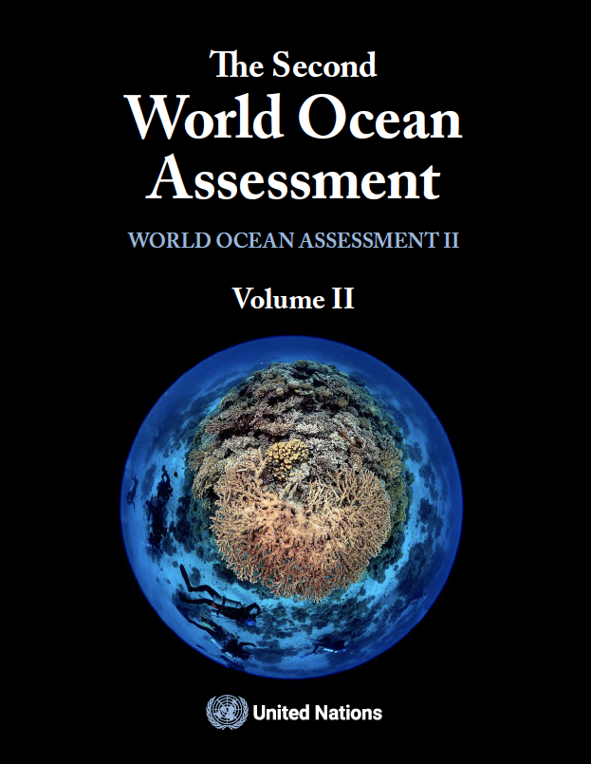
World Ocean Assessment II
Chapter 8: Trends in the state of human society in relation to the ocean
8A Coastal communities and maritime industries
8B Human health as affected by the ocean
The ocean supports a wide range of economic activities, including the harvesting of food, shipping, seabed mining, offshore hydrocarbon exploration and exploitation, tourism and recreation, use of marine genetic resources, production of fresh water by desalinization and production of salt. The various economic activities are steadily growing in scale.
https://www.un.org/regularprocess/sites/www.un.org.regularprocess/files/2011859-e-woa-ii-vol-ii.pdf

Slide 29
World Ocean Assessment III
Section 5: Social-Ecological Systems: A sustainable and inclusive ocean economy
Pressures including pollution, exploitation/extraction, allteration of coastal inputs (including that influenced by mega-droughts and mega-flooding, dams etc.), alteration of habitats (including destruction), alteration of oceanographic processes, illegal activities, inintended consequences of policy (harmful subsidies) Cumulative effects, contribution to climate change
Sustainability pathways, these forward-looking feasible pathways will identify the scientific data, tools and knowledge that could be utilized at local, regional and global scales to ensure that human activities are sustainable and inclusive, including those relating to governance, economy and markets, technology and management. They will also provide examples of where policy has been effective at enabling balance, restoring balance, adaptation etc.
Social components, where relevant chapters will include content on social aspects including benefits and disbenefits, equity (including social license), gender, Indigenous, traditional owner and local community knowledge
Sector relevant governance, where relevant chapters will include aspects on conventions, commitments and goals
https://www.un.org/regularprocess/sites/www.un.org.regularprocess/files/2_clean_ver_edited_annotated_outline_of_third_assessment_final_clean.pdf

Slide 30
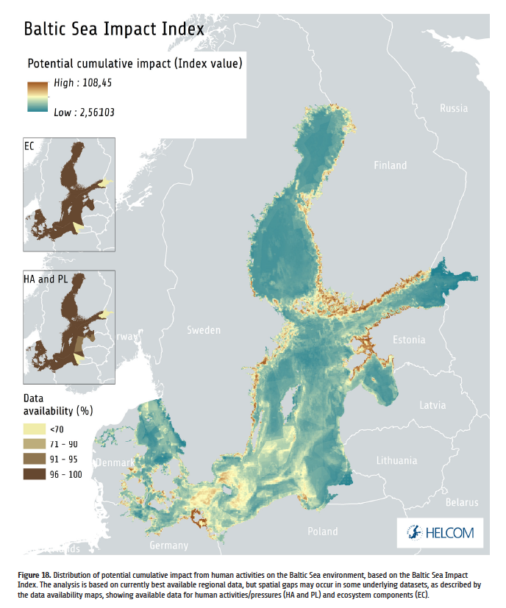
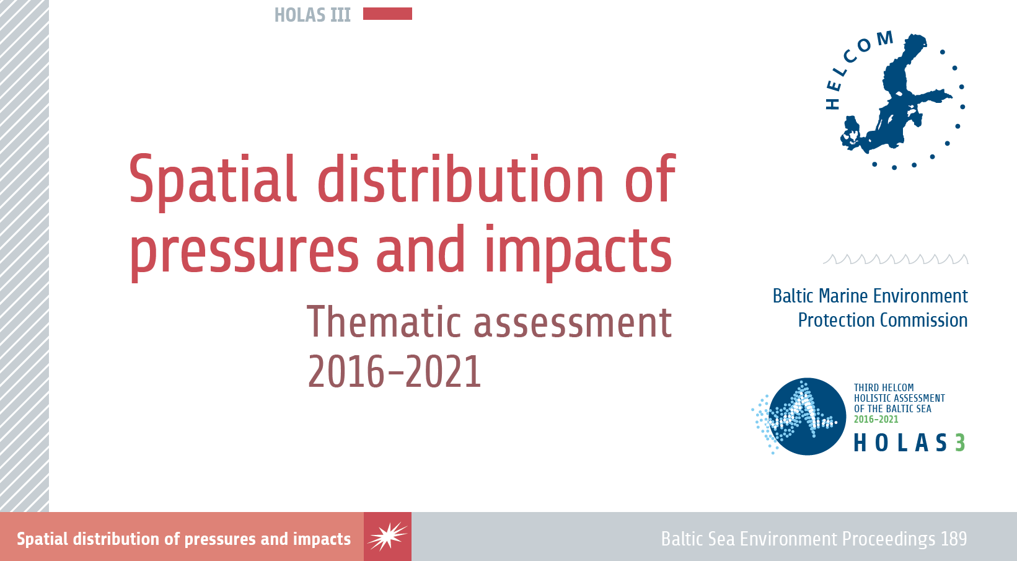
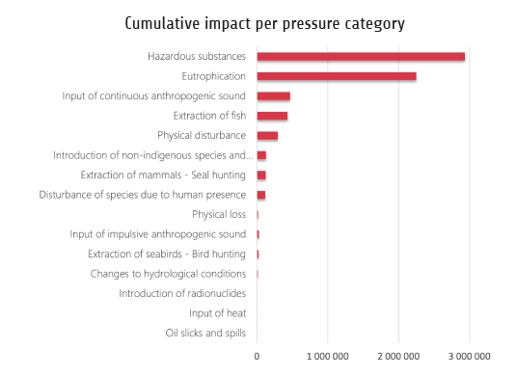

Slide 31
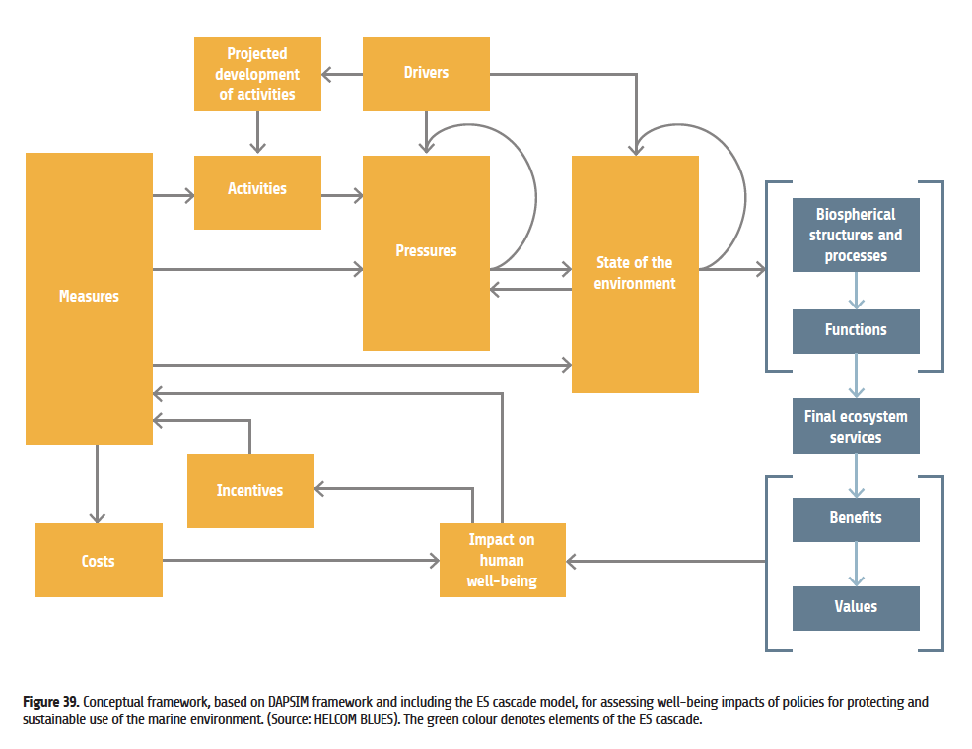
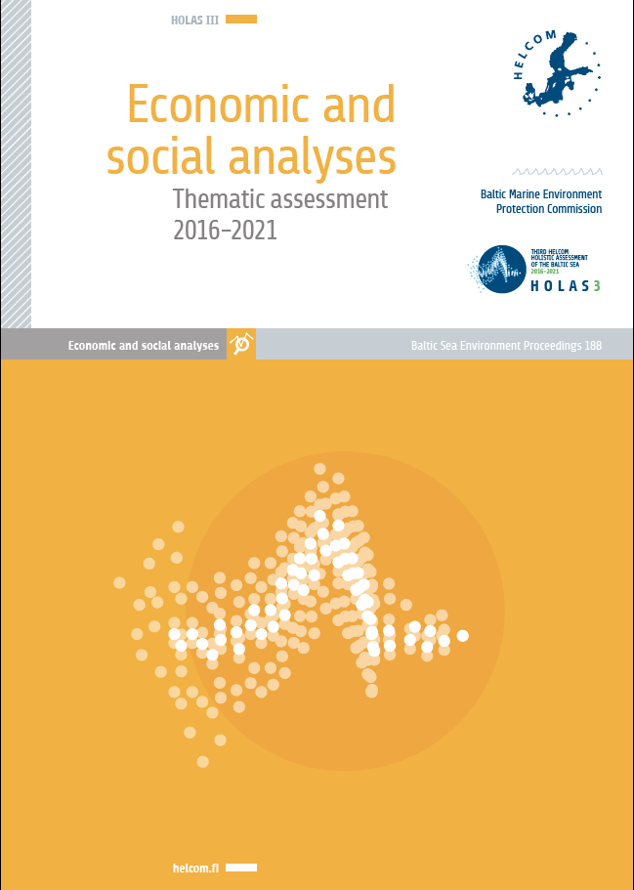

Slide 32
Mapping suitability of coastlines for practising different recreational activities in Estonia, Latvia and Finland.
A study conducted in the frame of Central Baltic Programme 2014-2020 project “From marine ecosystem accounting to integrated governance for sustainable planning of marine and coastal areas” (MAREA). Infor-mation from Forsblom et al. 2022.
Outcomes – MAREA (balticseaportal.net)

Slide 33
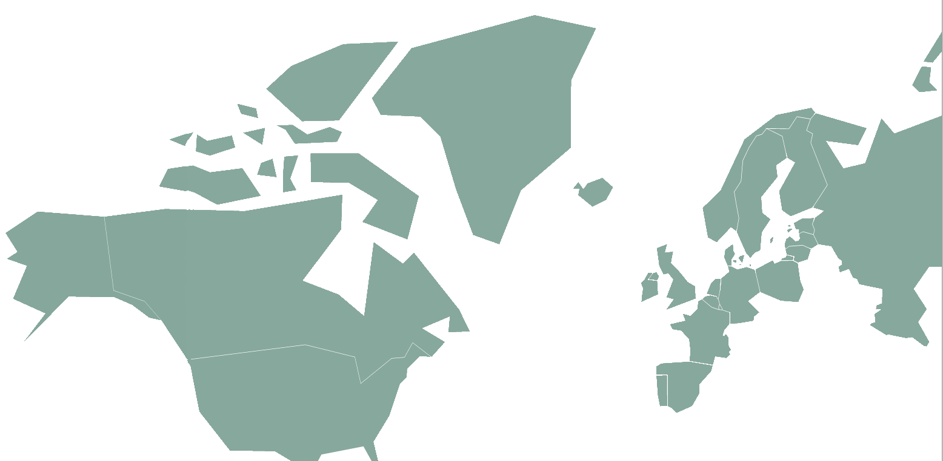
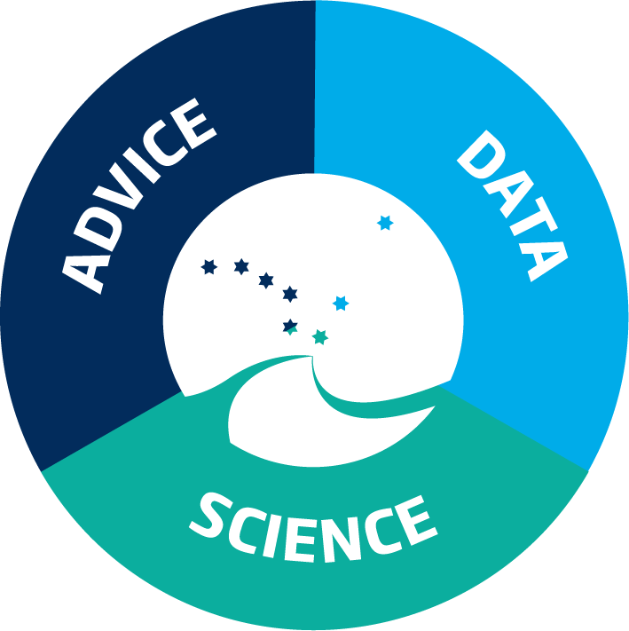
International Council for the Exploration of the Sea
To advance and share scientific understanding of marine ecosystems and the services they provide and to use this knowledge to generate
state-of-the-art advice for meeting conservation,
management, and sustainability goals.
150 Expert
Groups
> 3500
Experts
135 Scientific
Reports
239 Advisory
Products
www.ices.dk

Slide 34
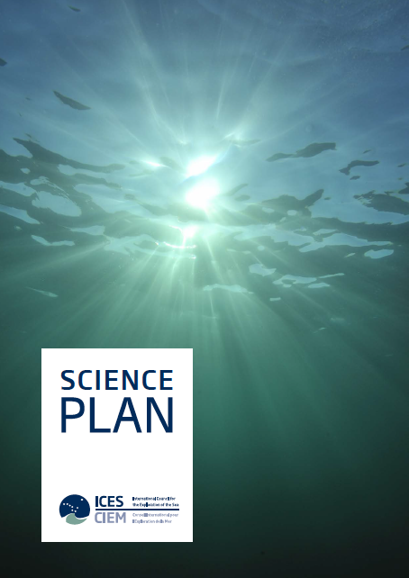
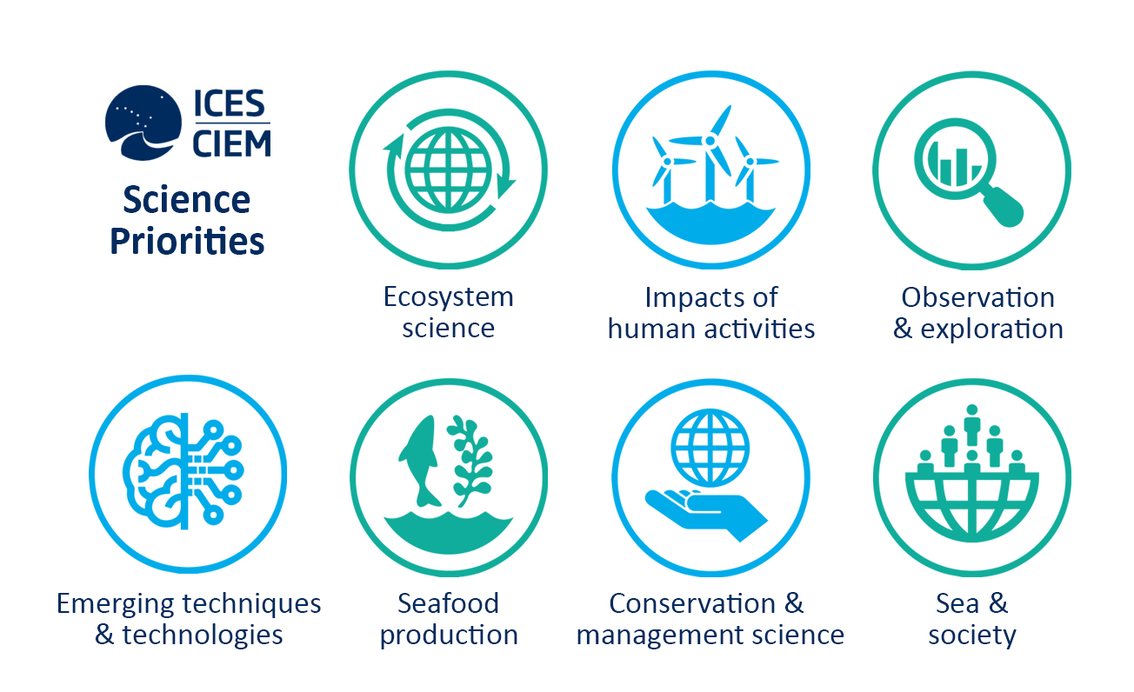
https://www.ices.dk/Science/Pages/Science_priorities.aspx

Slide 35
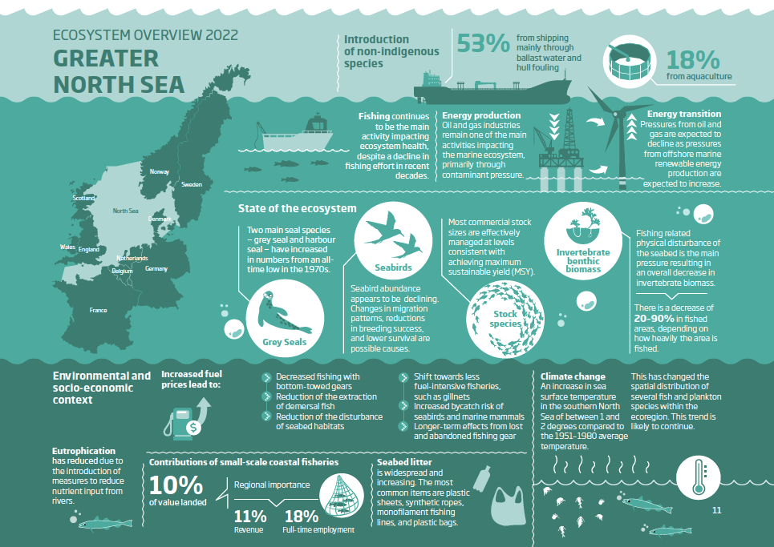
https://doi.org/10.17895/ices.pub.23519673

Slide 36
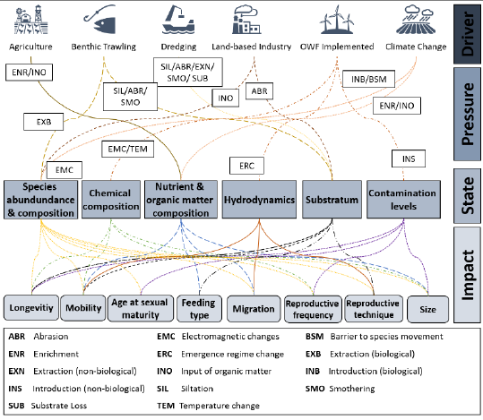
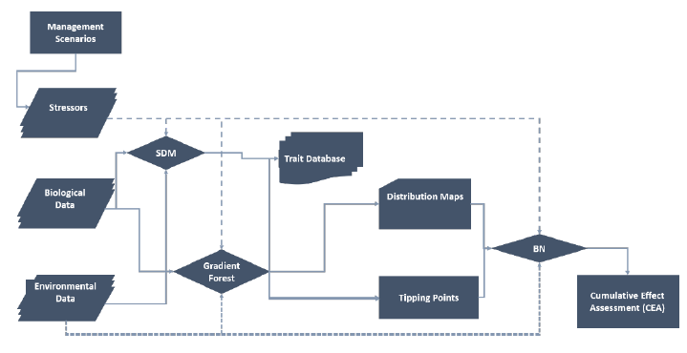
Working Group on Cumulative Effects Assessment Approaches in Management (WGCEAM)
ICES. 2022. Working Group on Cumulative Effects Assessment Approaches in Management (WGCEAM; outputs from 2021 meeting). ICES Scientific Reports. 4:8. 13 pp. http://doi.org/10.17895/ices.pub.10040

Slide 37
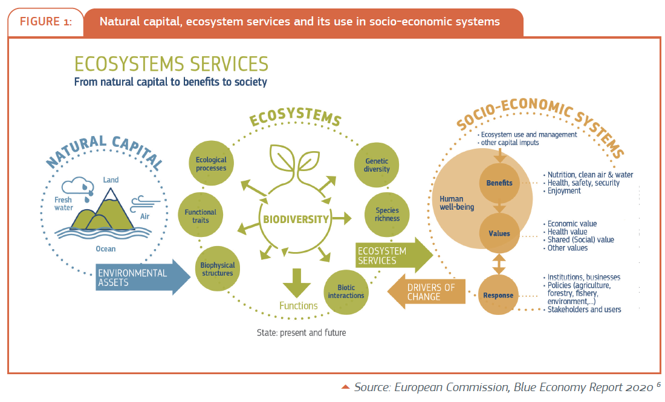
EC (2020): The EU Blue Economy Report 2020. https://ec.europa.eu/maritimeaffairs/sites/maritimeaffairs/files/2020_06_blue_economy_infographics_hd.pdf

Slide 38
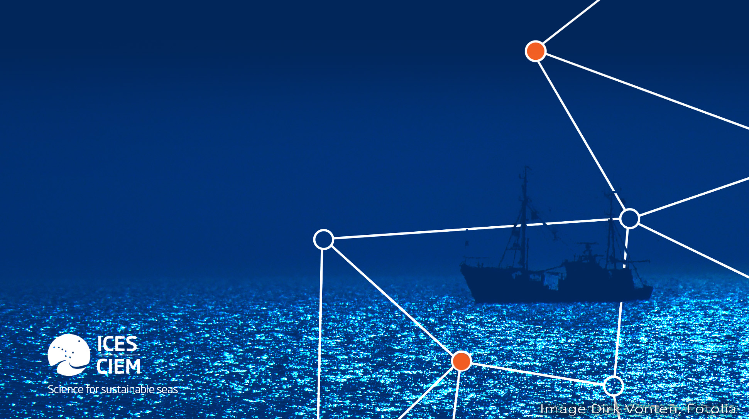
Thank you

Slide 39
References and relevant documents
European Commission, Directorate-General for Maritime Affairs and Fisheries, Joint Research Centre, Borriello, A., Calvo Santos, A., Ghiani, M., et al., The EU blue economy report 2023, Publications Office of the European Union, 2023, https://data.europa.eu/doi/10.2771/7151
European Commission, European Climate, Infrastructure and Environment Executive Agency, Sustainability criteria for the blue economy : main report, Publications Office, 2021, https://data.europa.eu/doi/10.2826/399476
European Commission, European Climate, Infrastructure and Environment Executive Agency, Sustainability criteria for the blue economy : guidelines, Publications Office, 2021, https://data.europa.eu/doi/10.2826/43842
FAO Fisheries Technical Paper. No. 443. Rome, FAO. 2003. 71 p., https://www.fao.org/3/y4773e/y4773e.pdf, accessed 20.08.2023
Forsblom L, J Kotta, E Virtanen, M Nurmi, N Kallio, FR Barboza, R Aps, I Kotta, H Jänes, H Orav-Kotta, R Szava-Kovats, L Lees, A Kõivupuu, S Loite, K Herkül, A Ruskule, K Veidemane, A Reķe, H Kuosa, TY Lai and S Jernberg (2022) D.T1.1.1. High-resolution maps on the intensity and extent of ecosystem services supply in the transnational pilot area. Deliverable of MAREA project. http://marea.balticseaportal.net/outputs/
HELCOM (2023): HELCOM Thematic assessment of spatial distribution of pressures and impacts 2016-2021. Baltic Sea Environment Proceedings No. 189., https://helcom.fi/post_type_publ/holas3_spa
HELCOM Thematic assessment of economic and social analyses 2016-2021. Baltic Sea Environment Proceedings No. 188., https://helcom.fi/post_type_publ/holas3_esa
United Nations (2023) The Sustainable Development Goals Report 2023: Special Edition, https://unstats.un.org/sdgs/report/2023/, accessed 20.08.2023
United Nations (2023) Trade and Environment Review 2023 - Building a sustainable and resilient ocean economy beyond 2030, https://unctad.org/system/files/official-document/ditcted2023d1_en.pdf, accessed 20.08.2023

